Slide 1
University Workshop Series
Power Platform and AI Builder
Glendon Thaiw, Technology Specialist (Azure & Bizapps)
Notes:
Hey everyone - I'm Glendon, a Technical Specialist with the Microsoft Business Applications team in Singapore.
Thank you so much for taking the time for today’s session – we really appreciate the opportunity.
In the next 20 mins or so, I'd be walking you through the Dynamics 365 Omnichannel for Customer Service experience.

Slide 2
Agenda
TRANSFORMATION ENABLERS
Introduction to Microsoft Power Platform and AI Builder
Building Models with AI Builder
- Object Detection Model
- Form Processing Model
Building Canvas Apps
- Online Shopping Assistant Application
- Form Processing Automation Application
Workshop Resources
Notes:
To kickstart the session, I’d begin by briefly introducing the Dynamics 365 omnichannel for customer service suite, and discuss some interesting features that I really enjoy.
I will then go into how you can bring this into the classroom to enable our students at the Institute of Technical Education using a training manual/workshop created for this solution.
The end-to-end training manual takes the learner on a journey to provision and configure an omnichannel for customer service environment and guides them to implement modular pieces to enable different functionalities.
I will end off with a quick demonstration of the end product of what we can expect from a student from completing this training manual.

Slide 3
Introduction to Microsoft Power Platform and AI Builder
Hands-on Training Lab Overview
What is Microsoft Power Platform?
What are the individual components?
What specifically is Power Platform Canvas app? What is AI builder?
Notes:
D365 Omnichannel for Customer Service Hands-on Training Lab Overview
Now that we understand Dynamics 365 Omnichannel for Customer Service, let us discuss how we can bring this into the classroom by utilizing a training manual built for the solution.
This training manual has been created by one of our supporting architects at Microsoft – and it encompasses an end-to-end learning journey to start operating with the platform. Taking the form of a word document, it contains step-by-step instructions to get an environment up and running.

Slide 4




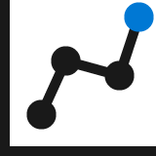




Power Platform: Everyone’s platform for transformation
Power Apps
Drive business processes
Improve engagements with customers and employees
No Code
Drag and drop experiences that are like PowerPoint
Power Automate
Power Virtual Agents
Low Code
Drag and drop plus Excel-like formulas for functionality
Automate response metrics
Analyze data from apps and bots
Power BI
Code First
Professional development and extensibility across Microsoft
AI Builder
Dataverse
Data Connectors
Management Tools
Notes:
Brings together 4 services to increase drive business value and increase ROI
to drive business processes through Power Apps, improve engagements with customers and employees through Power Virtual Agents, analyze data from apps and bots through Power BI and automate response metrics to drive business processes through power automate
All built on and supported by Dataverse which allows for external data connectors and in-built AI builder
As well as management tools to manage the current systems

Slide 5

















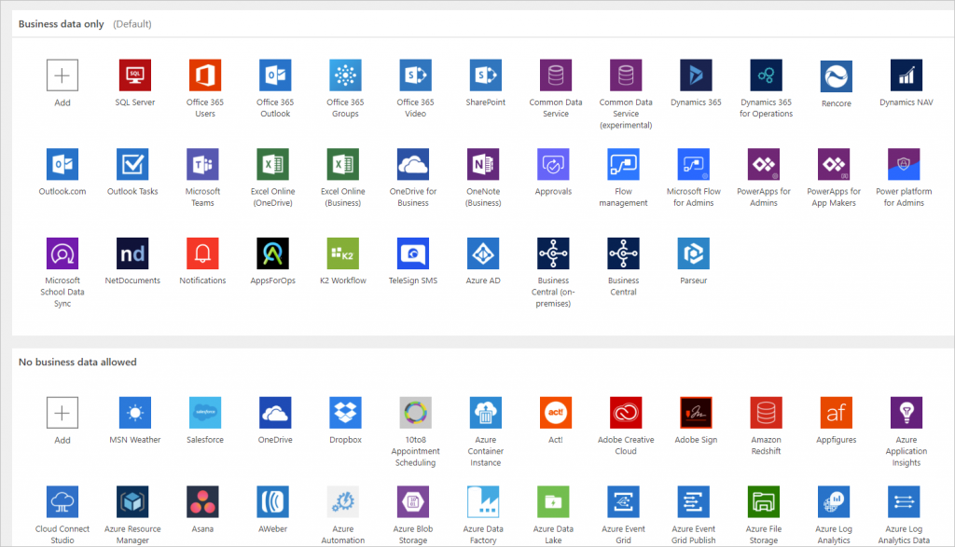
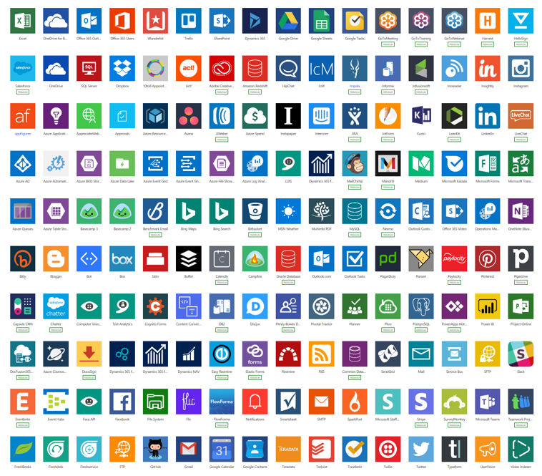
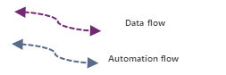
Anatomy of a Power Platform
Internal Users
Other roles + Targeted Roles
Internal Users
Targeted Users
External Users
Suppliers, Customers, Providers,
Embed Apps and Analytics
Cognitive
Experience
Measures
KPIs
Model Driven Apps
Dynamics and Non-Dynamics Apps
Canvas Apps
Portals
Power Virtual Agents
Search
Power BI
Business analytics
Power Apps
Application development
Language
Security
Knowledge
Business Unit / Sub BU / Teams
Services
Policy Management (DLP, Use, Share, …)
Hierarchical
Azure AD Based / Organization Wide
Field Level Security
May use
Common Data Service
Triggered, on-demand or recurring
AI Builder
Speech
Power Automate
Process automation
Office
Apps
Data and Integration
Use
Use
Labs
Data connectors
Vision
Business Non-Business Custom
Extend
External
Systems
Notes:
1. Experience, 2. Data & Integration & 3) External Systems

Slide 6
AI Builder Low-code AI for apps and processes
Low-code AI solutions for Power Platform leveraging the power of Azure AI.
Native integration with Common Data Service enables data from CDS, Azure Data Lakes.
Leverage predictions directly from Common Data Service across your Power Platform solutions, Dynamics 365, or Microsoft 365.
Prediction
Vision
Vision
Language
Binary classification
Predict and classify fields in CDS.
Forms processing
Extract structured data from digital paper, PDFs, and forms.
Object detection
Detect any object (via custom training) through camera or image control.
Text classification
Classify, group and categorize any text in CDS.
Notes:
AI Builder is a platform capability that allows easily adding AI to Power Automate, Power Apps and Dynamics 1st Party Apps. This enables makers to automate tasks and predict outcomes without having to involve data scientists.

Slide 7
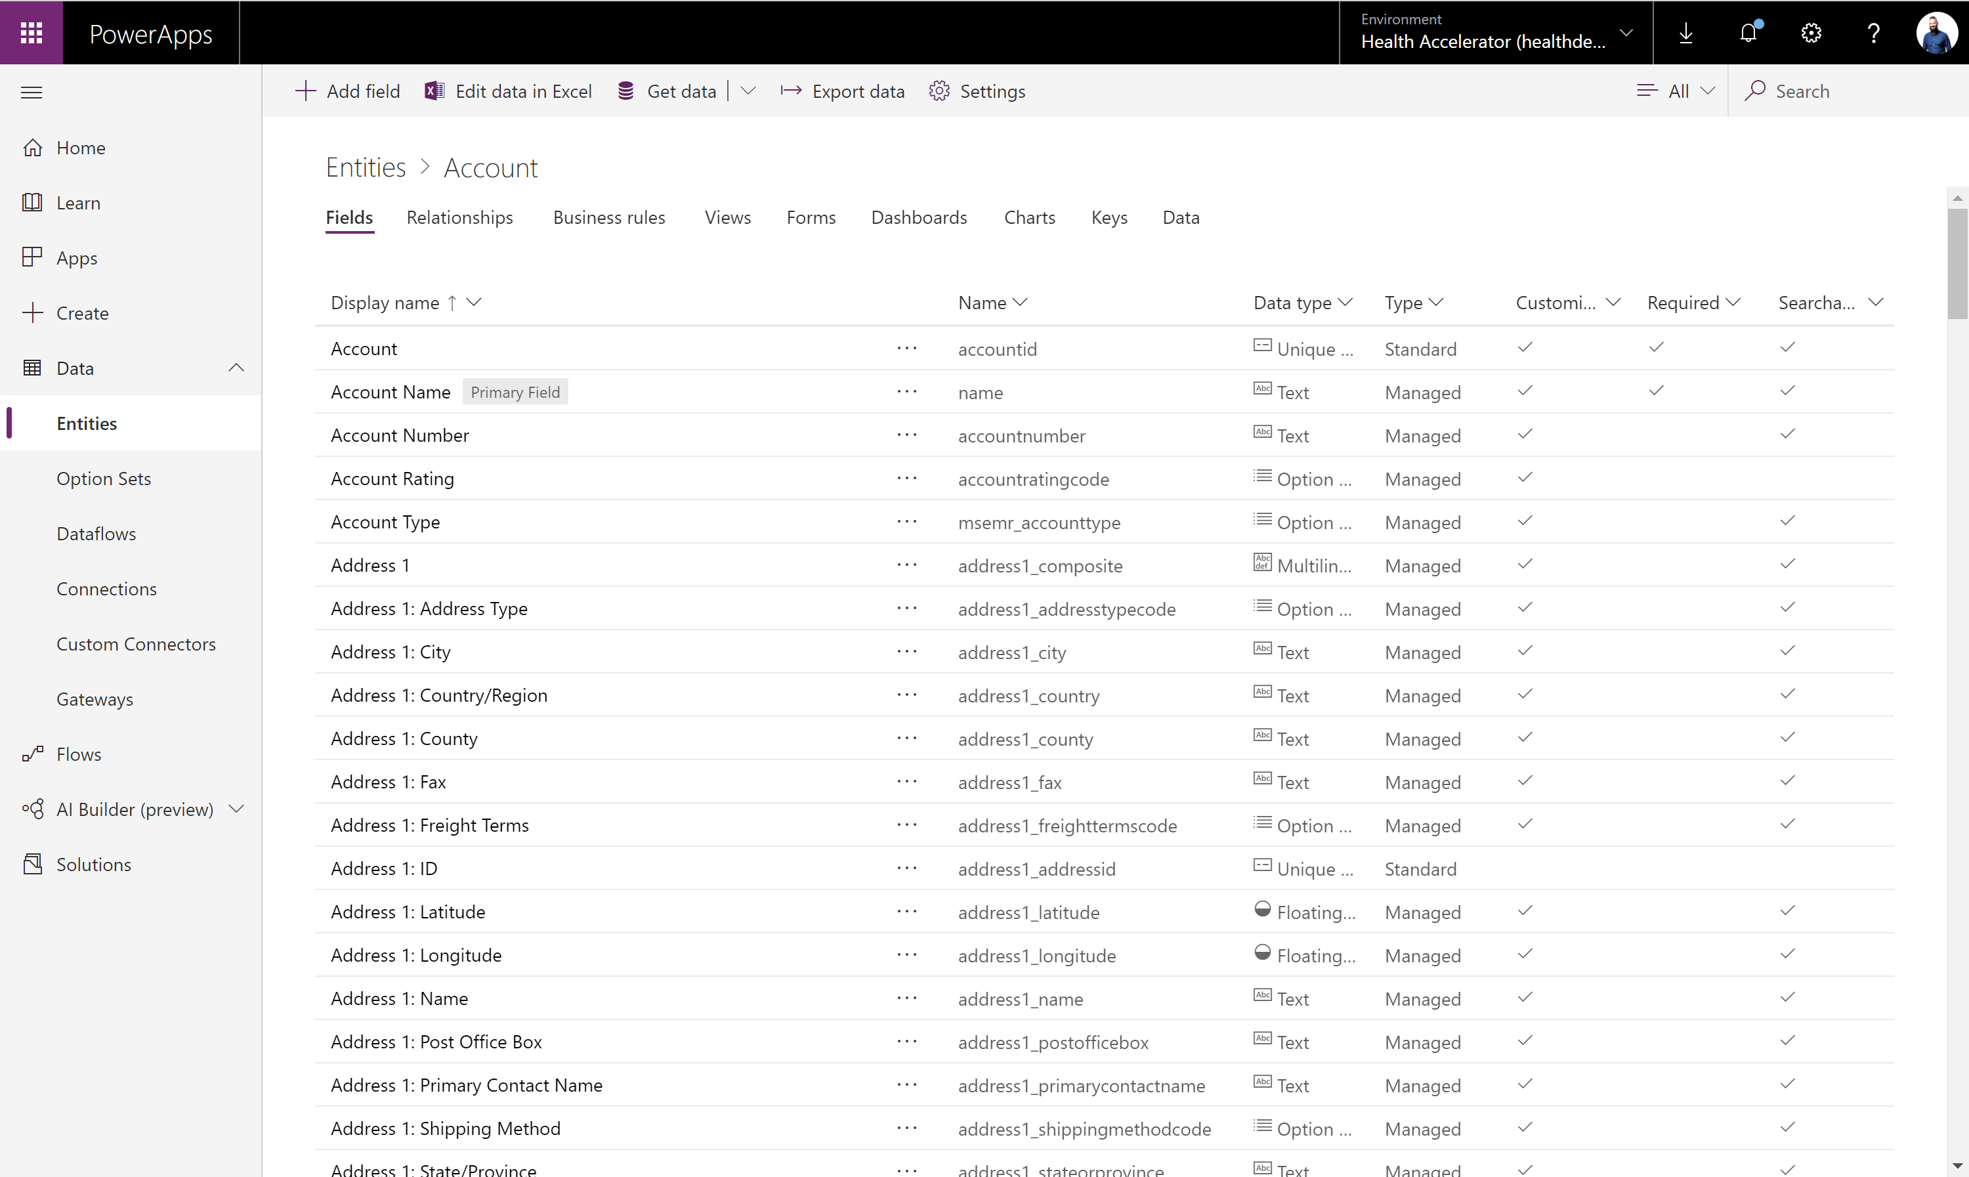

Dataverse Put all your data to work
Jumpstart apps using an extensible data model with business logic, security and integration built in.
Extend data and processes to external and anonymous users with Power Apps portals.
Support all your data: relational data, file and blob storage, logs and search indexing.
Effortless Dynamics 365, Office 365 and Azure integration as well as powerful integration capabilities.
Notes:
A mature data platform to manage data used by business applications, CDS is the platform that sits under the Dynamics 365 Sales, Service and Marketing business applications and is offered as a service to the Platform. An initial schema is defined by the Common Data Model. CDS provides built-in capabilities for business rules, workflows, calculated and rollup fields and more. CDS secures data using a configurable security model, that offers hierarchical, row level and field level security and auditing capabilities.
The Common Data Service (CDS) is a mature data platform used to securely store data for business applications built on Power Apps. CDS is an abstraction on top of underlying Azure cloud data management services to make it easier to build business applications. CDS provides not just data storage, but a way to implement business logic that enforces business rules and automation against the data. Data in CDS is organized as entities, for example account and contact would be two examples of entities. These entities can have relationships that define the business connection between the data stored in an entity. For example, John is the primary contact for Contoso would be expressed as a relationship from account to contact. The security model of CDS enables data protection down to the field level on individual records. A more thorough discussion of security will be covered in the security section of this paper.
CDS databases are created in the context of a Power Platform environment. Each environment can have only a single CDS database. CDS databases can be provisioned by you or licensed individuals in your organization to support their custom applications. A CDS databases is automatically provisioned when a Dynamics 365 Customer Engagement application is added to your tenant. The CDS language and currency settings cannot be changed afterwards, enterprise organizations that operate in multiple regions should align on a base language and base currency.

Slide 8
Dataverse Implements the Common Data Model (CDM)
CDM SCHEMA
App1
App2
AppN
Core
SALES
SERVICE
SOLUTIONS
Education
Account
CRM
Account
Competitor
Case
MARKETING
Activity
Appointment
Discount
Discount
Account
Contact
Campaign
Invoice
Contact
Contact
Currency
Contact
Opportunity
Resource
Event
Email
Lead
Order
Service
Marketing email
Goal
Marketing list
Order product
Scheduling group
Automotive
Healthcare
Letter
Phone call
Quote
Task
Marketing page
Microsoft Dataverse
Note
Social activity
…
…
…
Owner
…
Organization
Position
WEB
TALENT
TALENT
Task
Link Clicks
Department
Patient
Risk assessment
Medication
Financial Services
Web interactions
Job position
Practitioner
Encounter
Procedure
Nonprofit
Web page
Worker
Device
Episode of care
…
…
…
Care plan
ACCOUNT
ATTRIBUTES
Data source1
Data source2
Data sourceM
Description: Business that represents a customer or a potential customer
Account number
Account rating Code
Created on
Credit limit
Open deals
Open revenue
Territory id
Hotel group
Open source and shared data model that provides semantic consistency for data
Allows makers to more quickly develop applications and integrators to more easily interoperate across multiple systems
A growing set of solutions and partners that contribute to the effort by implementing CDM or extending with industry-specific domains
Notes:
An initial schema is defined by the Common Data Model on Microsoft Dataverse.
The common data model simplifies data management and app development by unifying data into a known form and applying structural and to ensure consistency across multiple apps and deployments

Slide 9


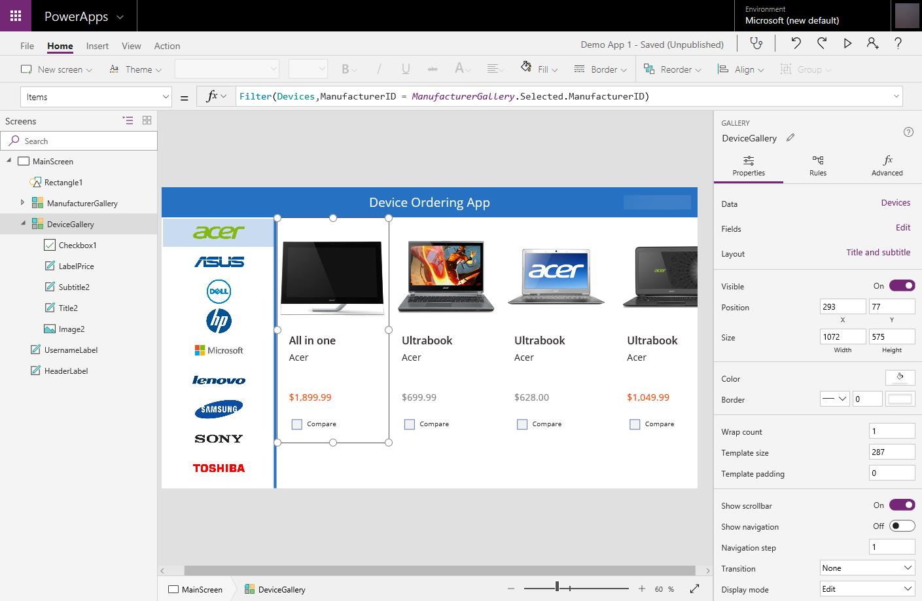
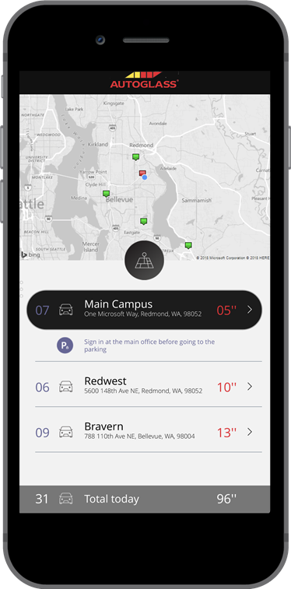

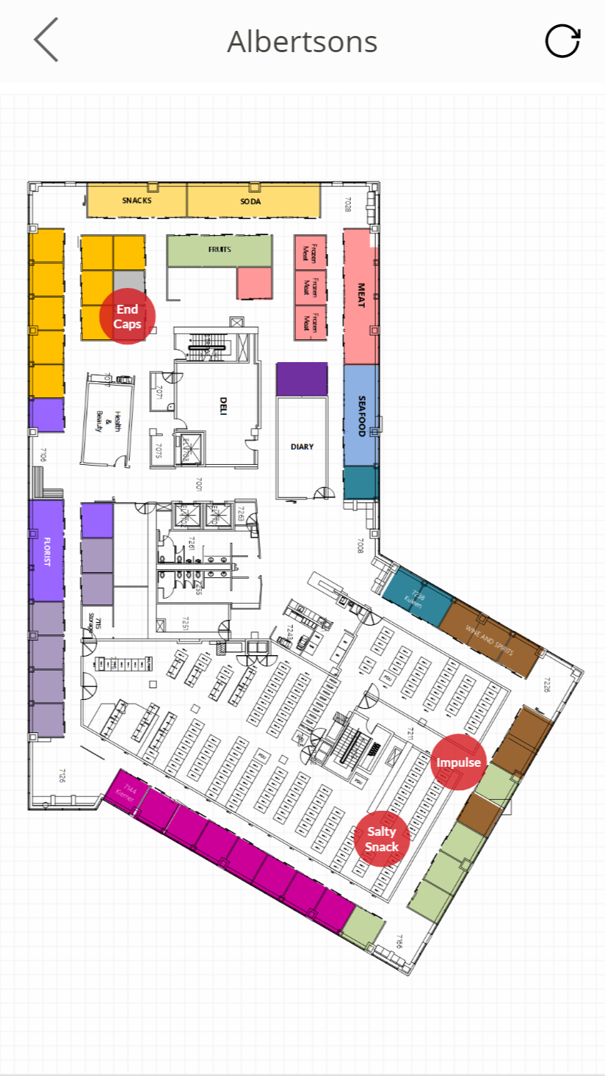
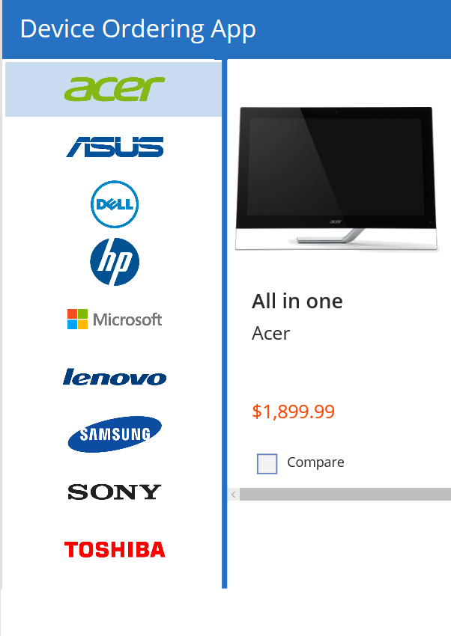
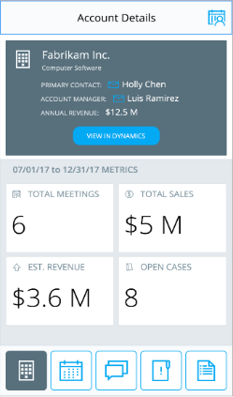

Power Apps: a low-code approach to build mobile apps, desktop apps and web portals
Easily build web & mobile apps with a full featured low-code / no-code platform.
Combine PowerPoint with Excel = Power Apps!
Add mixed reality experiences to your apps
Connect to your existing data with 450+ pre-built connectors and custom connectors
Leverage device features such as camera, GPS, microphone and pen & ink with no code!
Business users solve business problems. Partnering with Pro-dev’s to extend and integrate. No limits.
Integrates with Microsoft Teams, Office 365, Azure, Dynamics, Power Automate & Power BI
Strong enterprise governance & security

Slide 10
Unlock more with Microsoft Power Apps Power Apps combines a simple visual approach with advanced tools, making it easier for everyone to build better apps more efficiently
Get to better solutions faster
Enable employees to build and launch their own apps to address their own business challenges – with nothing to slow them down
Make better use of resources
Free up limited pro dev resources and enable them to work faster on mission critical apps and enterprise wide solutions
Optimize existing investments
Build apps that integrate seamlessly with your Office 365, Dynamics 365 and Azure tools and data
Drive business value and increase ROI

Slide 11
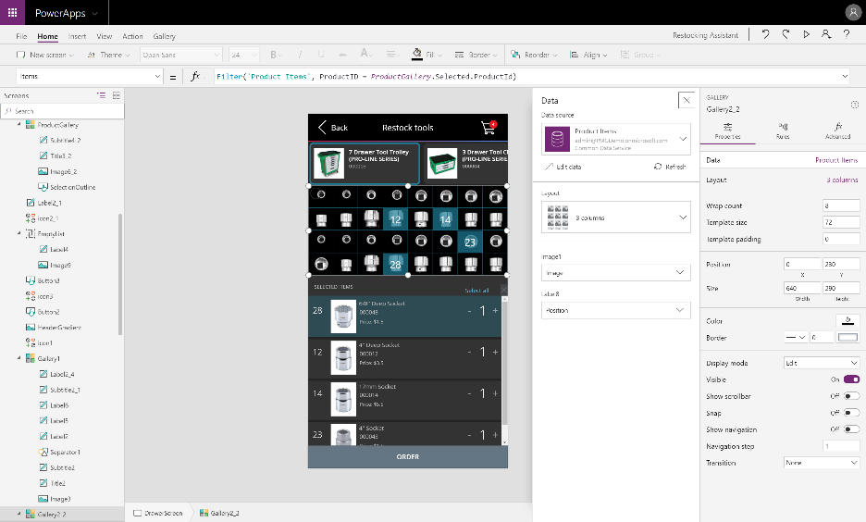
Power Apps Studio
Authoring experience for creating Power Apps
7
Always updated with the latest builds and allows you to work in your browser
4
6
5
1
Left navigation bar
Middle pane
Right-hand pane
Properties
Formular bar
Ribbon
Additional items
2
3
Notes:
If all of them don’t fit to your needs, configure it further with the Canvas apps authoring experience
Start with your data
Start with a blank canvas
Start with a template

Slide 12
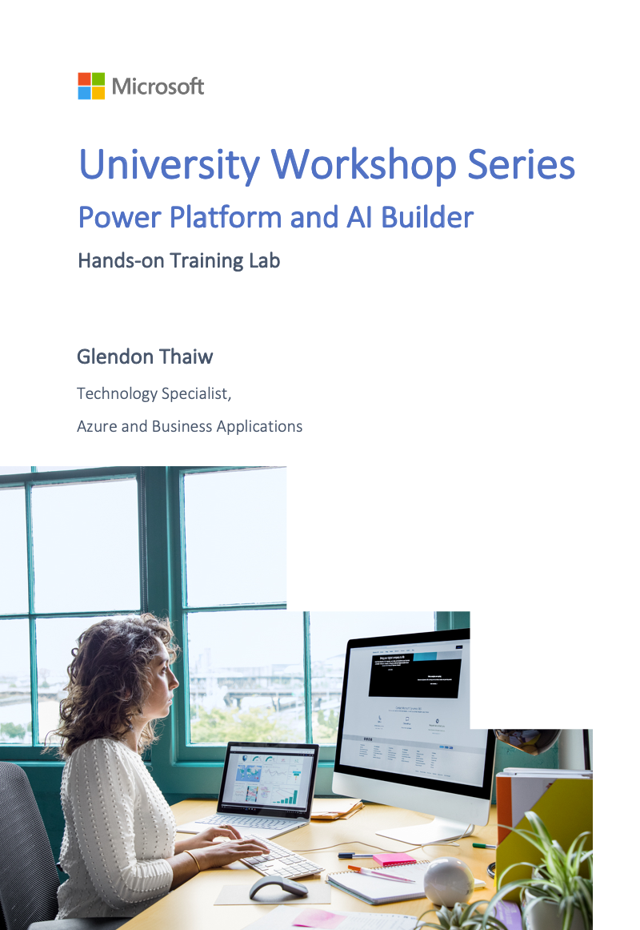
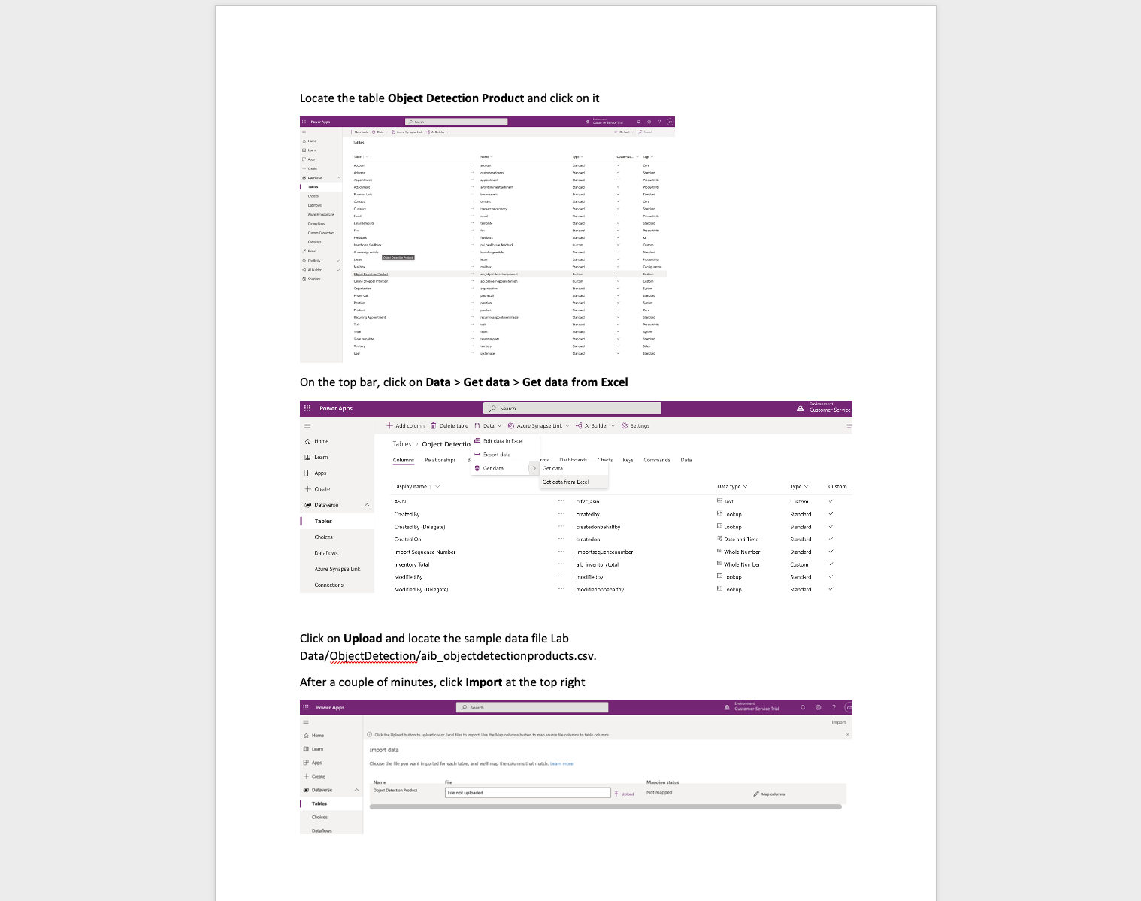
Workshop Resources
Hands-on Training Lab Overview
Notes:
D365 Omnichannel for Customer Service Hands-on Training Lab Overview
Now that we understand Dynamics 365 Omnichannel for Customer Service, let us discuss how we can bring this into the classroom by utilizing a training manual built for the solution.
This training manual has been created by one of our supporting architects at Microsoft – and it encompasses an end-to-end learning journey to start operating with the platform. Taking the form of a word document, it contains step-by-step instructions to get an environment up and running.

Slide 13
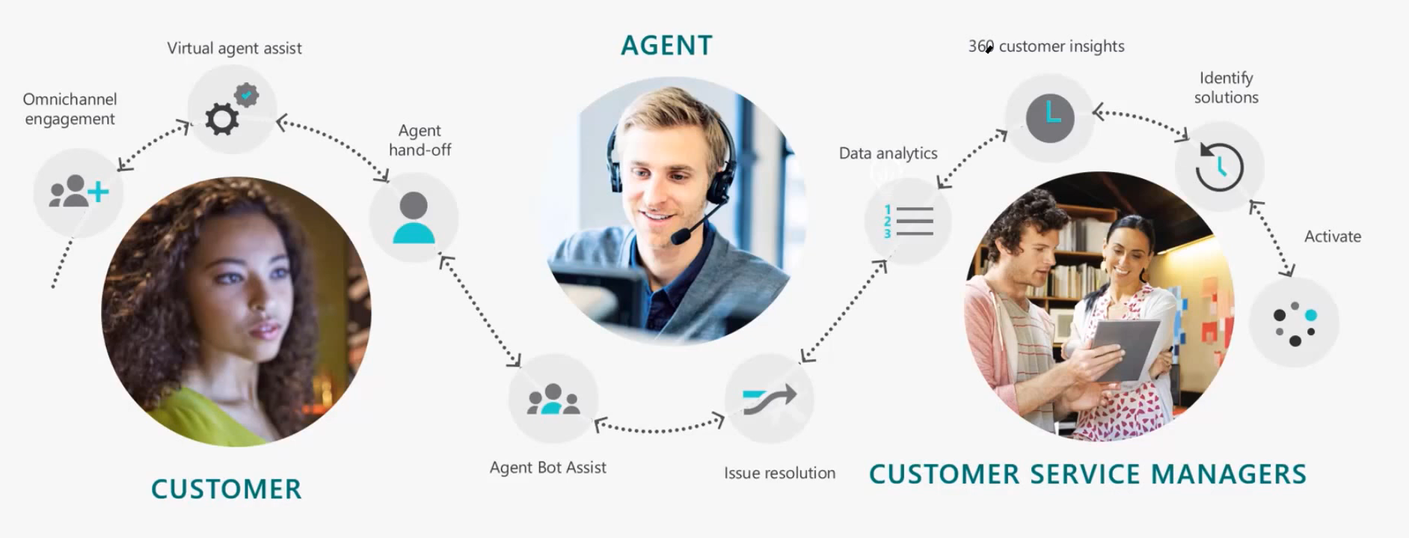
Introduction to D365 Omnichannel for Customer Service
Enabling customer breaking silos and accelerating digital transformation
Notes:
Introduction to D365 Omnichannel for Customer Service
I’d like to start off by giving a quick introduction to Dynamics 365 Omnichannel for Customer Service – a one-stop shop for agent productivity and customer service success.
Omnichannel for Customer Service offers a suite of capabilities that extend the power of Dynamics 365 to enable organizations to instantly connect and engage with their customers across digital messaging channels. It provides a modern, customizable, high-productivity app that allows agents to engage with customers across different channels. The application offers contextual customer identification, real-time notification, integrated communication, and agent productivity tools like Knowledge Base integration, search, and case creation to ensure agents are effective.
On top of empowering customer service agents, this allows Customer Service managers to get real-time and historical visibility and insights into the operational efficiency of agents and the utilization across various channels. Enterprise-grade routing and work distribution engine allows customers to configure agent presence, availability, and routing rules, thus ensuring agents are working on the most relevant engagements. Managers and supervisors can also make use of out-of-the-box dashboards that provides KPIs and trends for supervisors to understand the overall state of the Customer service support experience at a glance.
All this contributes to delivering a world-class omnichannel experience for the customer from the first point of contact to case resolution for any organisation.

Slide 14
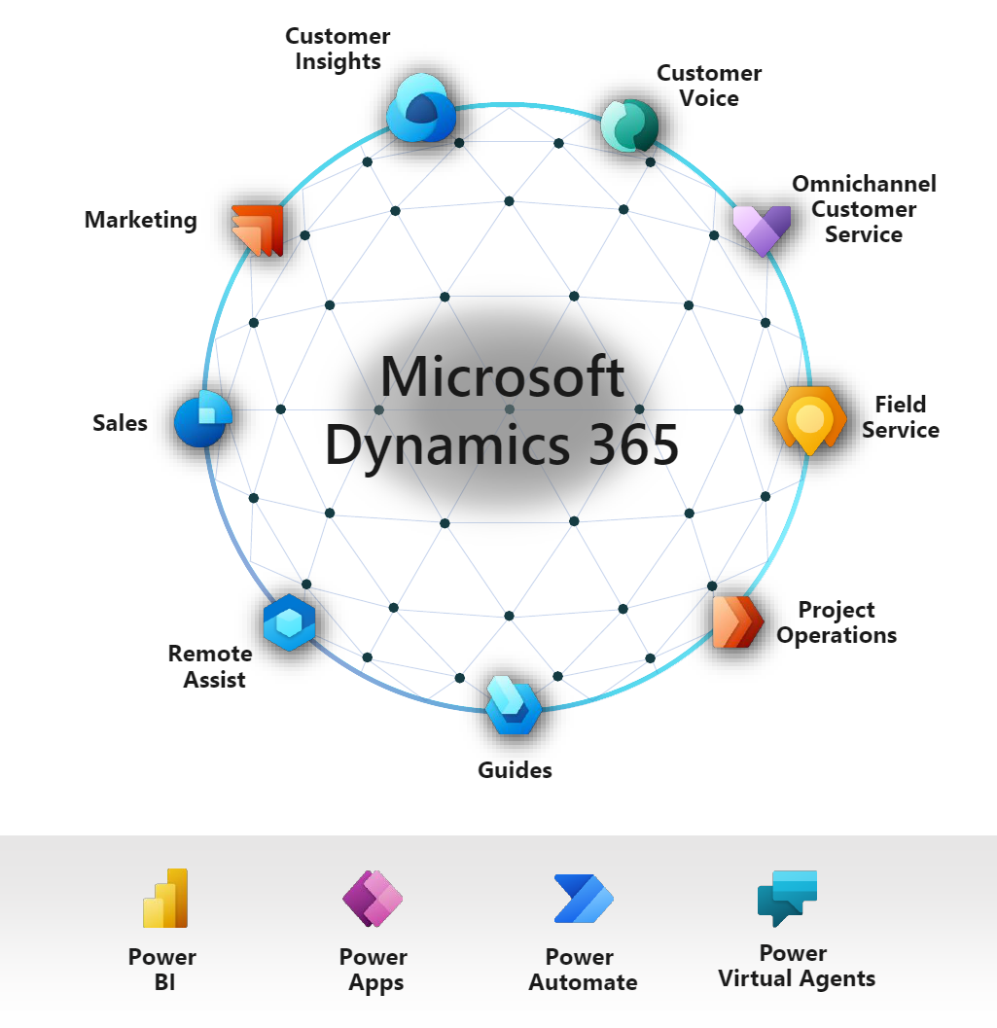
Introduction to D365 Omnichannel for Customer Service
Enabling customer breaking silos and accelerating digital transformation
Notes:
As I stated earlier, Omnichannel for Customer Service extends the power of the Dynamics 365 platform and is what we call a First-Party solution built by Microsoft having seen this growing demand in the market. What this is means for us is that the omnichannel for customer service solution possess the ability to have a seamless integration with the rest of the Microsoft Business Applications pieces to create elegant and sophisticated solutions.
For example, agents or system administrators can easily build targeted and compelling dashboards on Microsoft Power BI and bring them into the Dynamics 365 portal unified interface.
Additionally, through the use of the Microsoft Power Virtual Agents, users can develop intelligent chatbots and bring them into the live chat functionality of the omnichannel solution to deliver effective first contact resolution.
All of this is included in the training manual where I will further illustrate during the live demonstration later.

Slide 15
Introduction to D365 Omnichannel for Customer Service
Enabling customer breaking silos and accelerating digital transformation
Key Features
Session Management: Session panel allows agents to work with multiple customer sessions simultaneously
Customer Interaction: Conversation panel allows agents to communicate with customers across multiple channels
Multiple applications: Agents have access to relevant supporting applications in the context of the session
Customer Summary: Provides a single contextual view of the customer based on the current conversation
Quick access to familiar Dynamics 365 tools: Leverages existing D365 functionality, by providing agents access to record searching, quick record creation, and agent presence information
Real-Time notification: Agents review real-time notification messages of incoming communication from customers
Notes:
The omni-channel for customer service solution comes with many innovative and helpful features. Here are 6 to illustrate the capability of the platform.
Firstly, the session panel facilitates effective session management by allowing agents to work with multiple customer sessions simultaneously. They can switch between sessions without losing the context of the conversation or any customer details – thereby improving customer service productivity.
Secondly, the conversation panel allows agents to communicate with customers across multiple channels – delivering a coherent and cohesive experience no matter which medium the customer chooses to interact with the organization.
Next, the unified portal allows agents to gain access to multiple relevant supporting applications, collaborate with colleagues, and access pre-loaded knowledge base to be in a better position to serve their customers.
The very same unified platform also aggregates details and information regarding the customer – providing a single contextual source of truth to allow the agent to best assist their customers.
Again, as the solution is built on Dynamics 365, this allows agents to leverage on the familiar and powerful Dynamics 365 tools and functionalities such as record searching and quick record creation to minimize friction and maximise productivity.
Lastly, real-time notifications allow agents ro receive real-time messages of incoming information and communication from customers to ensure that we meet our intended service-level agreements.

Slide 16
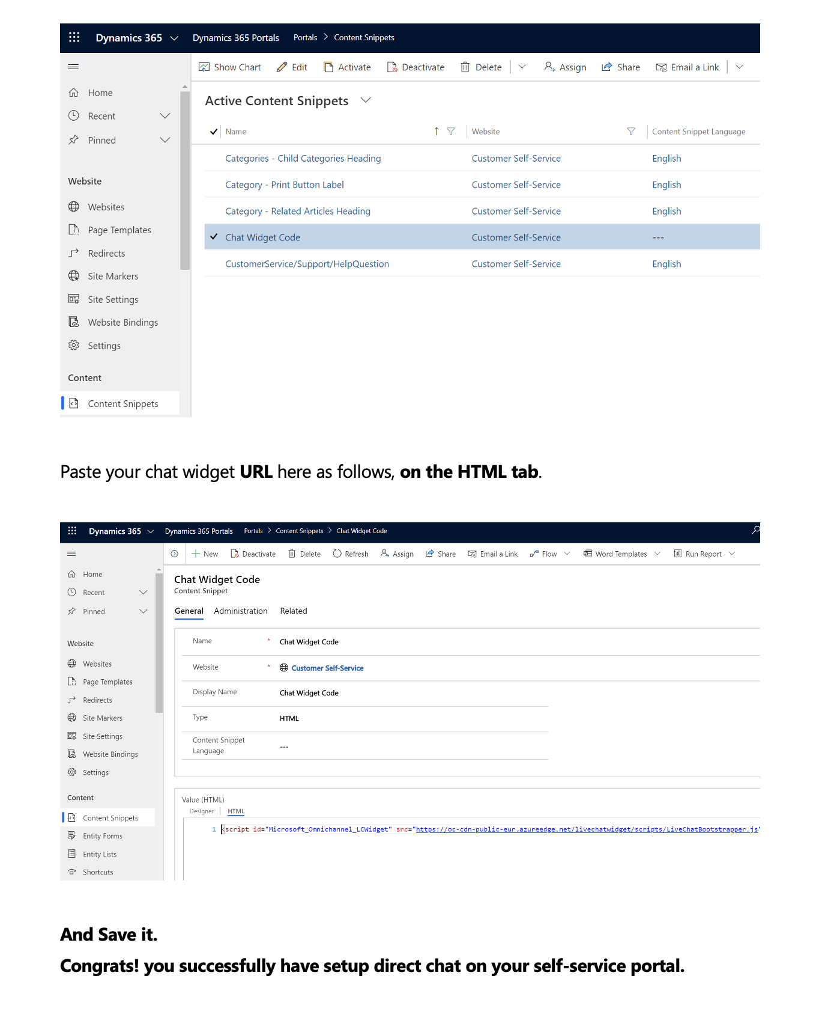
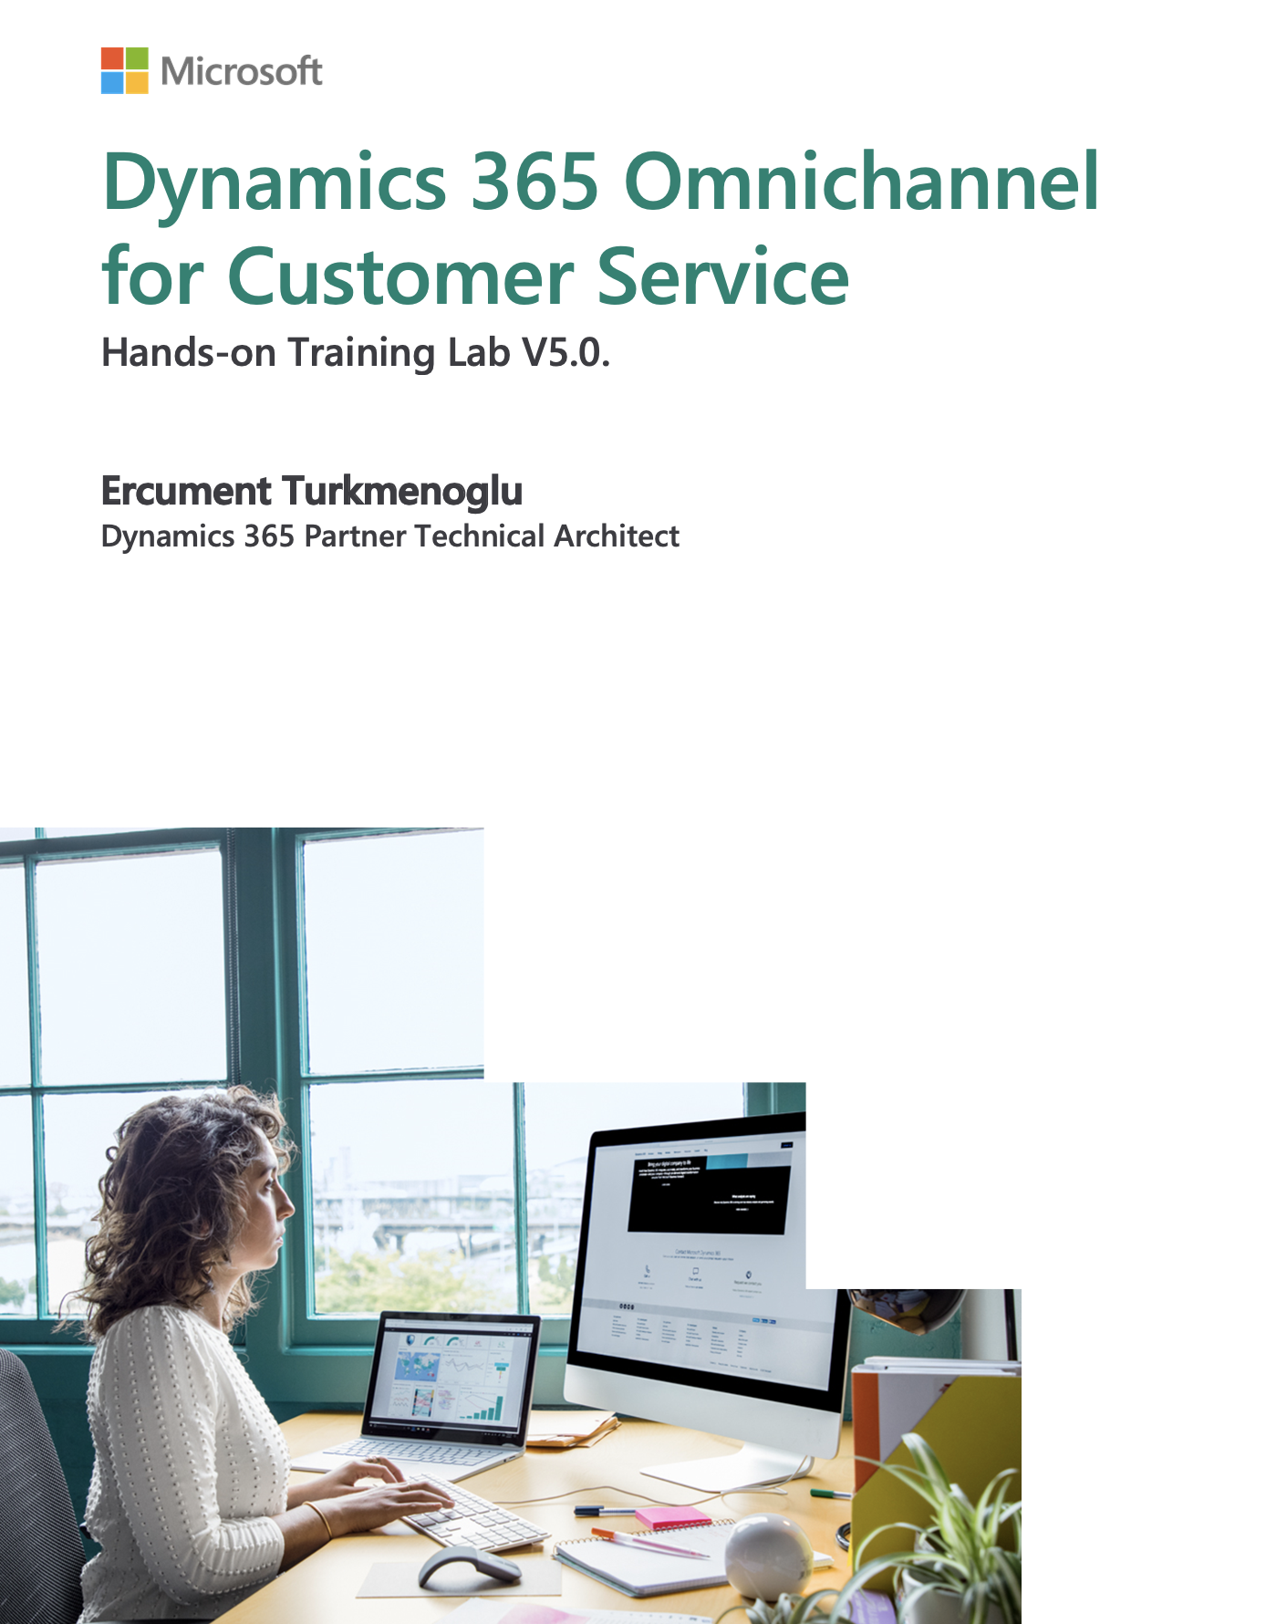
D365 Omnichannel for Customer Service
Hands-on Training Lab Overview
Notes:
D365 Omnichannel for Customer Service Hands-on Training Lab Overview
Now that we understand Dynamics 365 Omnichannel for Customer Service, let us discuss how we can bring this into the classroom by utilizing a training manual built for the solution.
This training manual has been created by one of our supporting architects at Microsoft – and it encompasses an end-to-end learning journey to start operating with the platform. Taking the form of a word document, it contains step-by-step instructions to get an environment up and running.

Slide 17
D365 Omnichannel for Customer Service
Hands-on Training Lab Overview
Curriculum
1. Provision trial environments
2. Configure Omnichannel for Live Chat
3. Configure Omnichannel for Facebook messenger integration
4. Configure Omnichannel for Voice/SMS/Whatsapp Integration with Twilio
5. Configure Smart Assist Bot
5. Adding PowerBI dashboards to D365*
6. Enable Real-time Translation with Azure Translator integration*
Notes:
D365 Omnichannel for Customer Service Hands-on Training Lab Overview
Let us take a look at the curriculum for the training workshop.
Packaged in individual sequential modules, it starts off by guiding the user through the prerequisites required to go through the lab. It brings the user through provisioning the different trial environments required such as a Office 365 Trial environment and of course a Dynamics 365 Customer Service Trial environment.
After setting up the environments, it guides the user to start configuring the omnichannel environment to implement the live chat capability. This embeds a chat widget on a front-facing portal application that when used by the customer, will be routed towards the dynamics 365 environment to be received by a customer service representative.
After the basic pieces are established, it introduces different modules to guide the user on integrating other communication channels to the solution such as Facebook messenger, Voice, SMS and even Whatsapp.
The final few modules are slightly more advanced where we introduce additional capabilities such as a Smart Assist Bot, adding powerBI dashboards to the Dynamics 365 portal and even activating real-time translation by creating a translator instance on Microsoft Azure.
Over the past few weeks, I went through the workshop front-to-back and found that it provided an exhaustive and holistic understanding of the different pieces within the fabric of the omnichannel solution.
The best part about the workshop lies in its modular nature. Therefore, depending on time allocated and scope, we can decide the bounds we would like our learners to undertake.

Slide 18
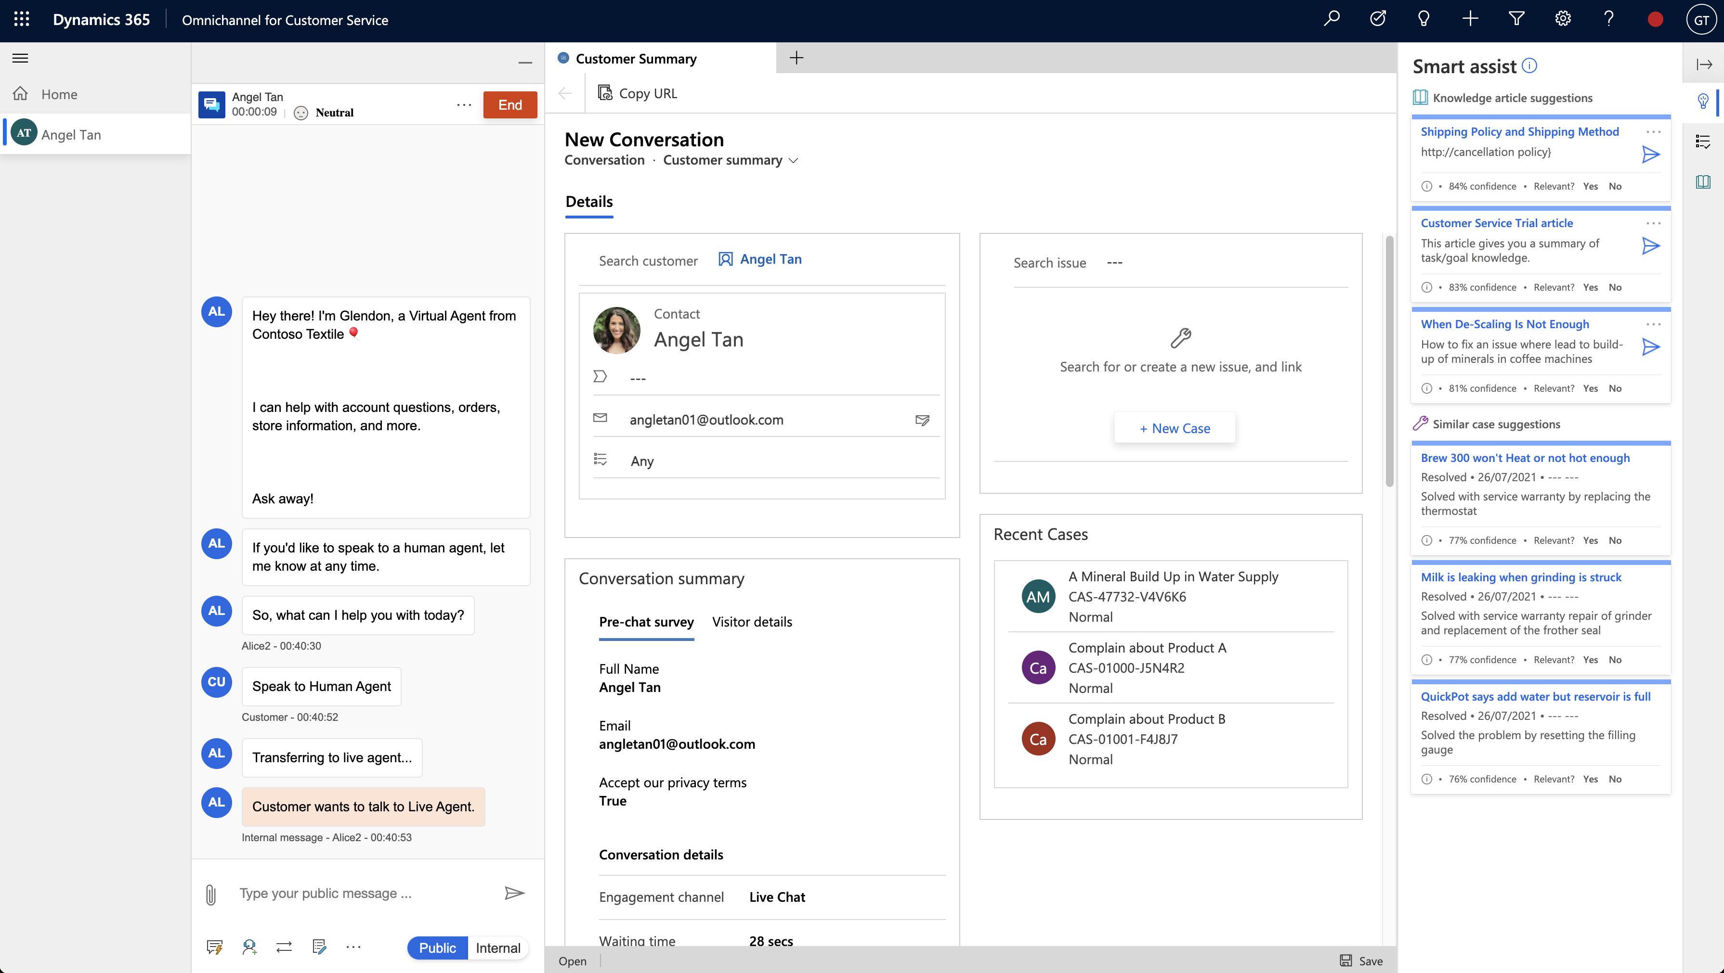
End-Product Feature Demo
Hands-on Training Lab Overview
Notes:
Now as we approach the end of the sharing, I’d like to do a quick demo on the end-state of what can be achieved by completing the training manual.
I will end off with a quick demonstration of the end product of what we can expect from a student from completing this training manual.

Slide 19
Questions and Answers

Slide 21
End-Product Feature Showcase
Enabling customer breaking silos and accelerating digital transformation
Resources
Self-service Customer Service Portal (Portal App)
Dynamics 365 Omnichannel for Customer Service Apps - Live chat capability integration with Portal, Facebook, Whatsapp, Voice Call and more - Agent session management - Customer 360 Overview through Unified interface panel and Dashboards
Power Virtual Agent - Integrates virtual agent for effective First Contact Resolution (FCR)
Notes:
Now as we approach the end of the sharing, I’d like to do a quick demo on the end-state of what can be achieved by completing the training manual.
I will end off with a quick demonstration of the end product of what we can expect from a student from completing this training manual.

Slide 22

Agenda
Introduction
Customer Engagement Challenges and New Approaches
Microsoft Business Applications
The Art of Possible
Intelligent Marketing engagement
Proactive sales engagement
Omni customer care engagement
Customer Success Manager Involvement
References
Q&A

Slide 23
Transformation Requirements
Customer expectations of digital service delivery in a consistent manner
Cross-department collaboration for better service
Expanding volume and complexity in data
Demand for omni-channel Customer engagement
Siloed applications with no common data structures
Security, privacy and regulatory requirements
Leverage existing investments and manage major risks
Constant pace of change in technology – AI/ML etc.
Notes:
Our interpretation of the challenges highlighted during the workshop:
Please refer to Appendix – Slide 22

Slide 24
Envision Opportunities
TRANSFORMATION ENABLERS
KEY SCENARIOS
Enhanced Relationship Management with deep insights.
Effective Customer data integration
1
Integrated Sales & Care mgmt tool
Omni-channel Engagement
Streamlined and Consistent Customer experience from sales to care
Customer feedback management
2
Knowledge management
Minimal Disruption to Existing Customer Experience while Driving Major Transformational Impact
Data insights and intelligence
3
AI and ML enabled services

Slide 25
Microsoft Dynamics 365
Enabling customer breaking silos and accelerating digital transformation

Slide 26
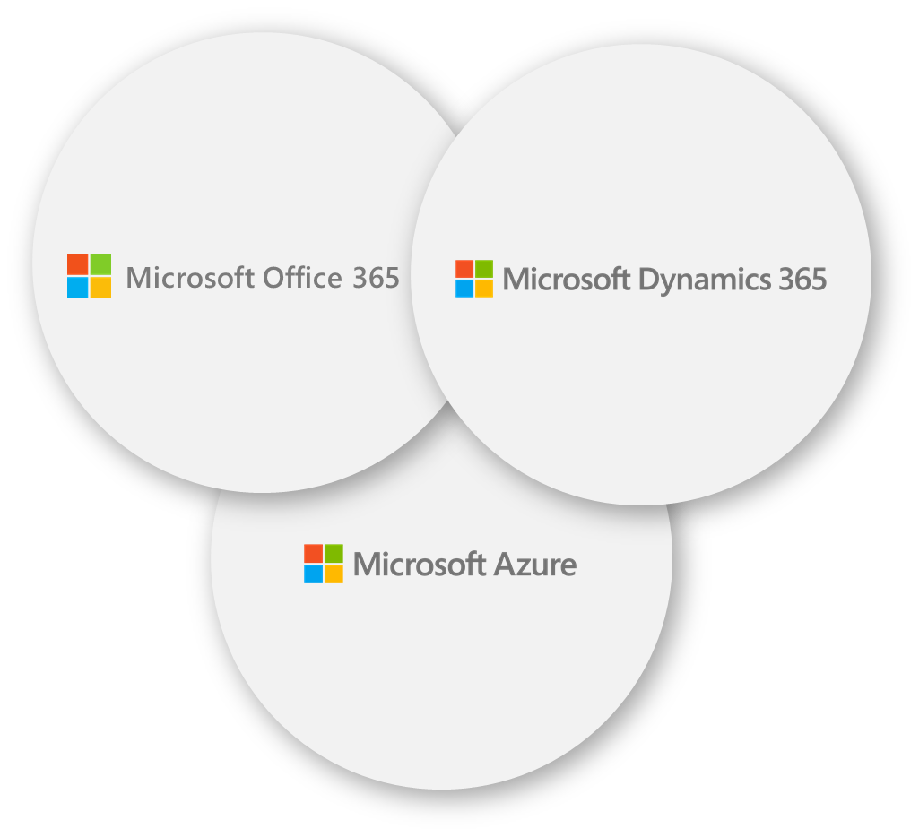

Microsoft Business Application
Connect your Customer and Organization …
… for your Employees to derive Intelligent Decisions
The Power of 3 Clouds - Productivity and Collaboration, Business Processes and Infrastructure and Data
Remove the complexity of disparate systems
Tear down the traditional silos of data and bring them together
Connect citizens, services, employees, and data across the enterprise
Embrace the cloud on your own terms in secure and compliant manner
Leverage on a broad portfolio of partner solutions
The Future in Artificial Intelligence
Data
Intelligence
Experiences
DATA + AI PLATFORM
INTELLIGENT AGENTS
Microsoft Bot Framework
Microsoft Cognitive Services
Machine Learning
Analytics in Big Data Stores
Conversational Agents
Cortana
BUSINESS SOLUTIONS
APPLICATIONS
Accelerators
Solutions
Practices
Partner Ecosystem
Office 365
Dynamics 365
Teams
Power BI

Slide 27
Reimagining Customer Engagement

Slide 28
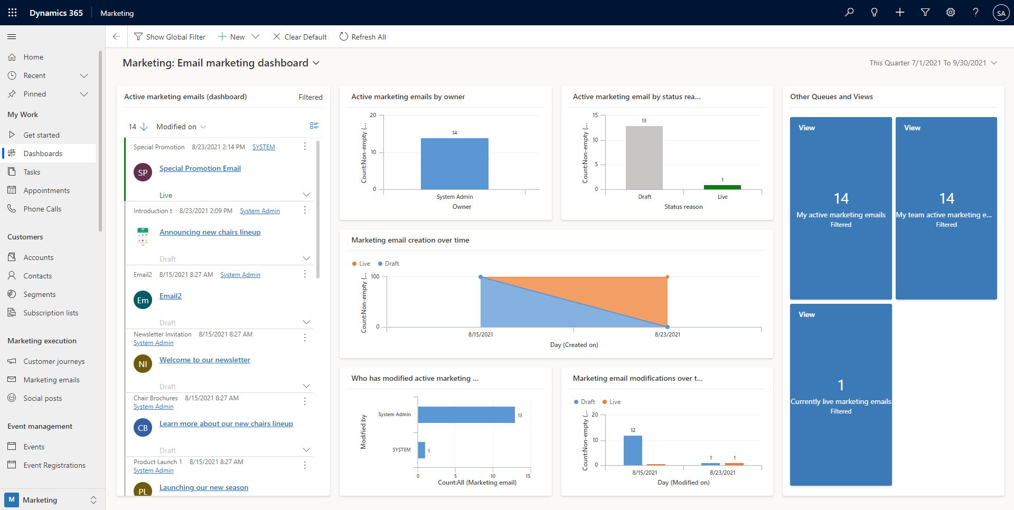

Slide 29
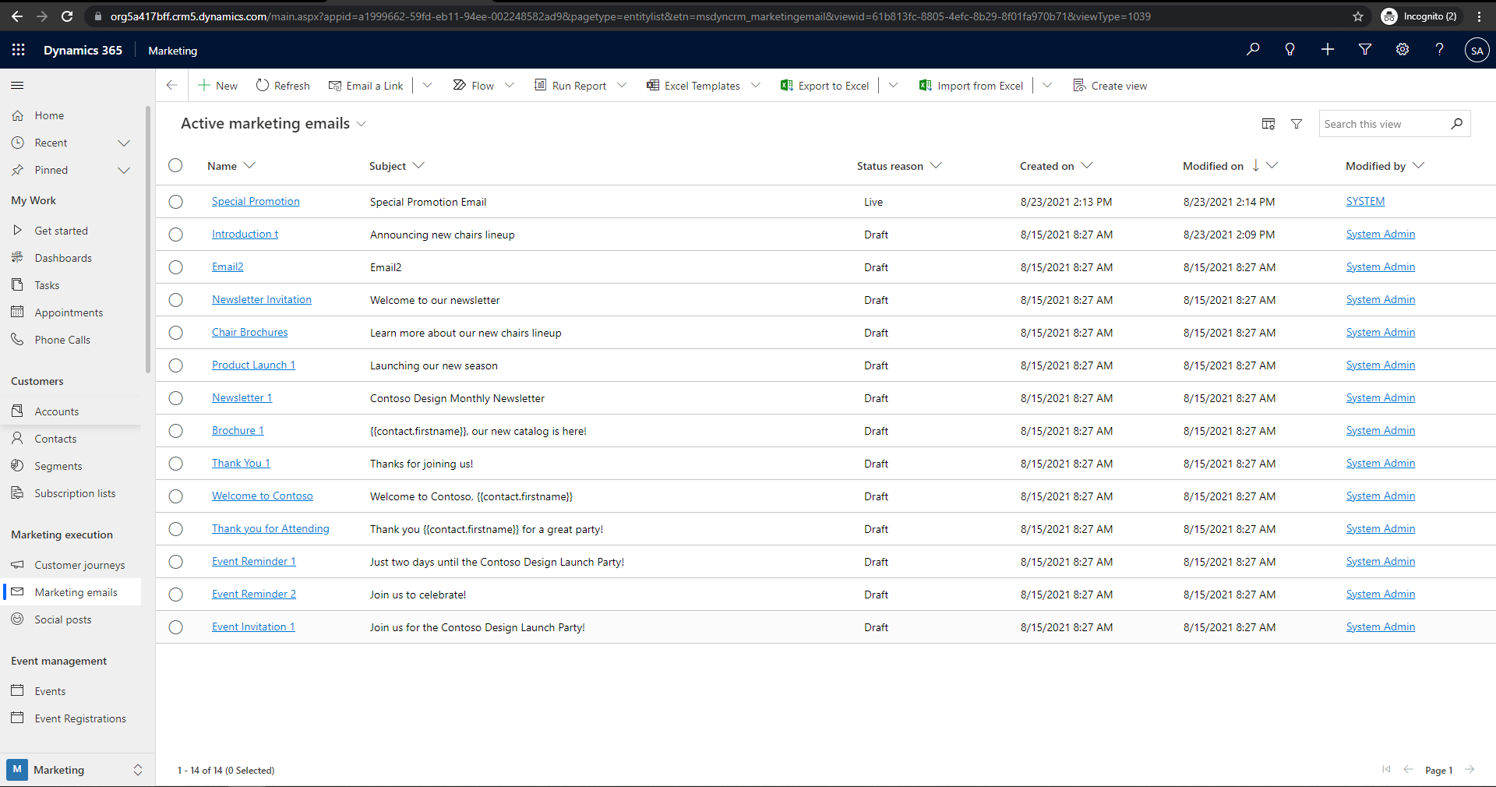

Slide 30
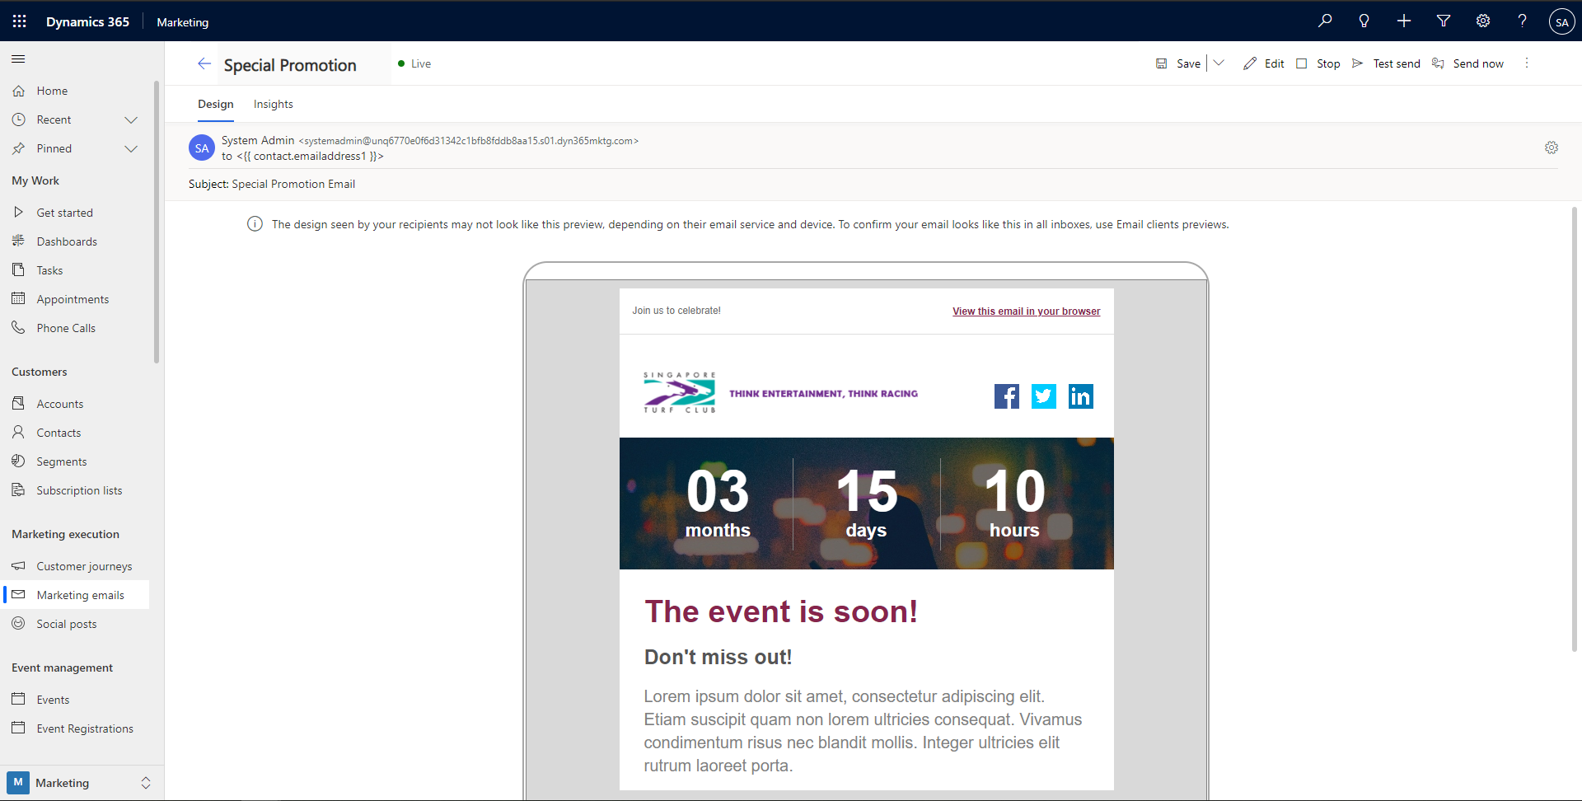

Slide 31
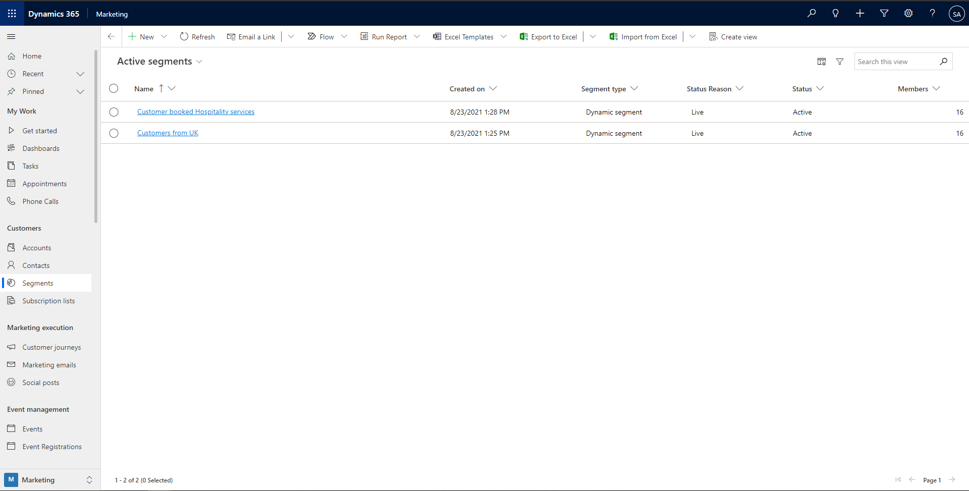

Slide 32
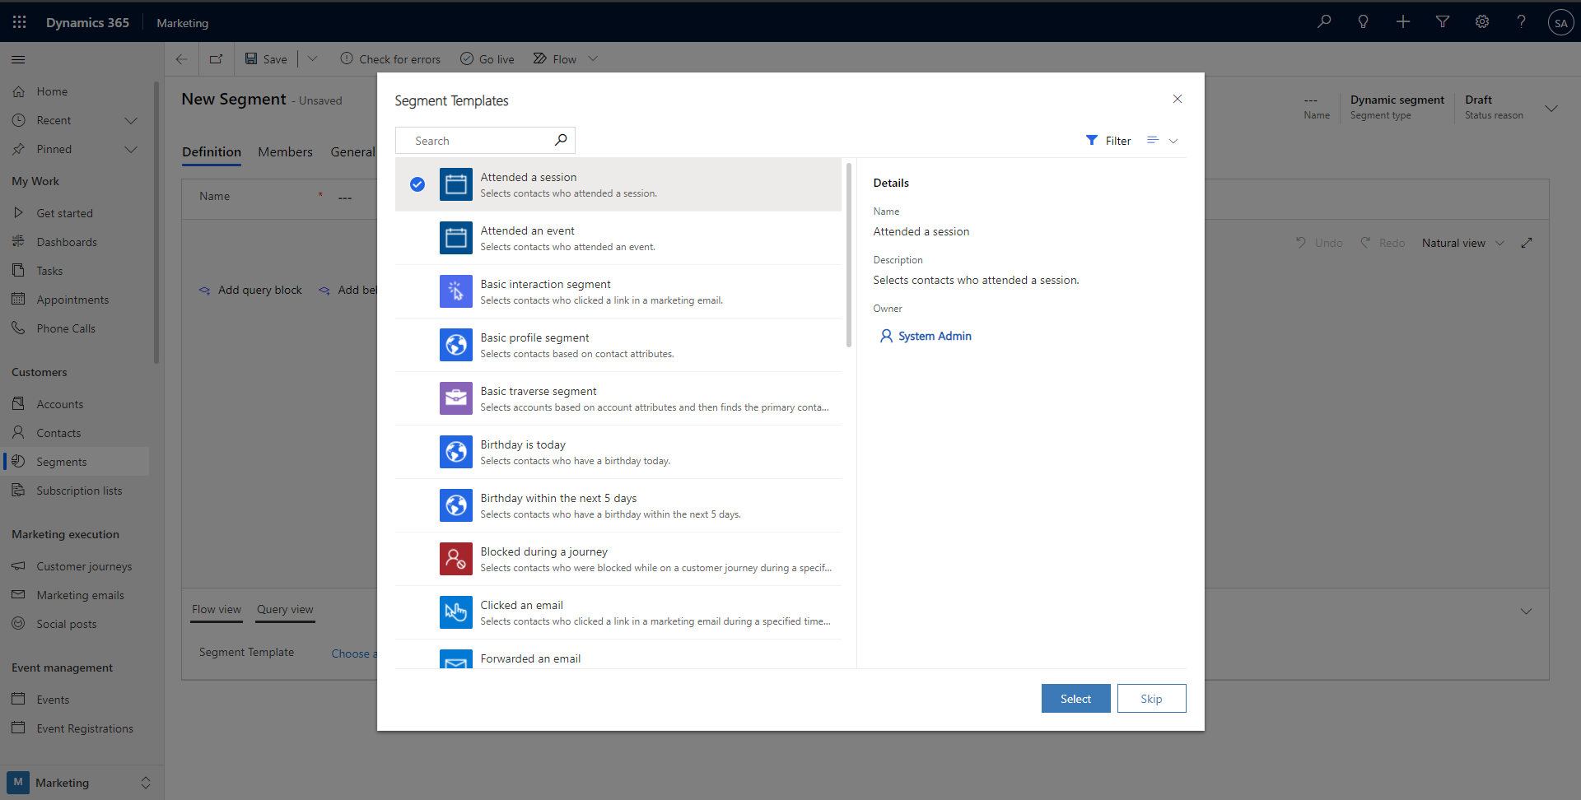

Slide 33
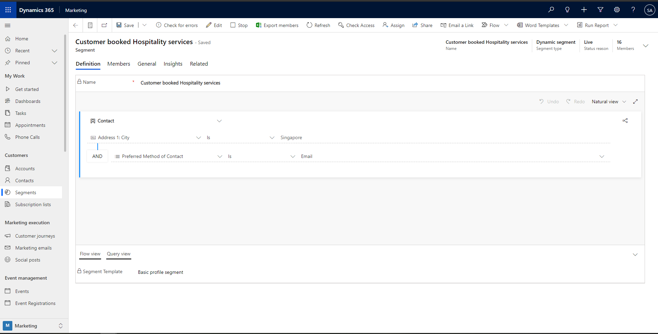

Slide 34
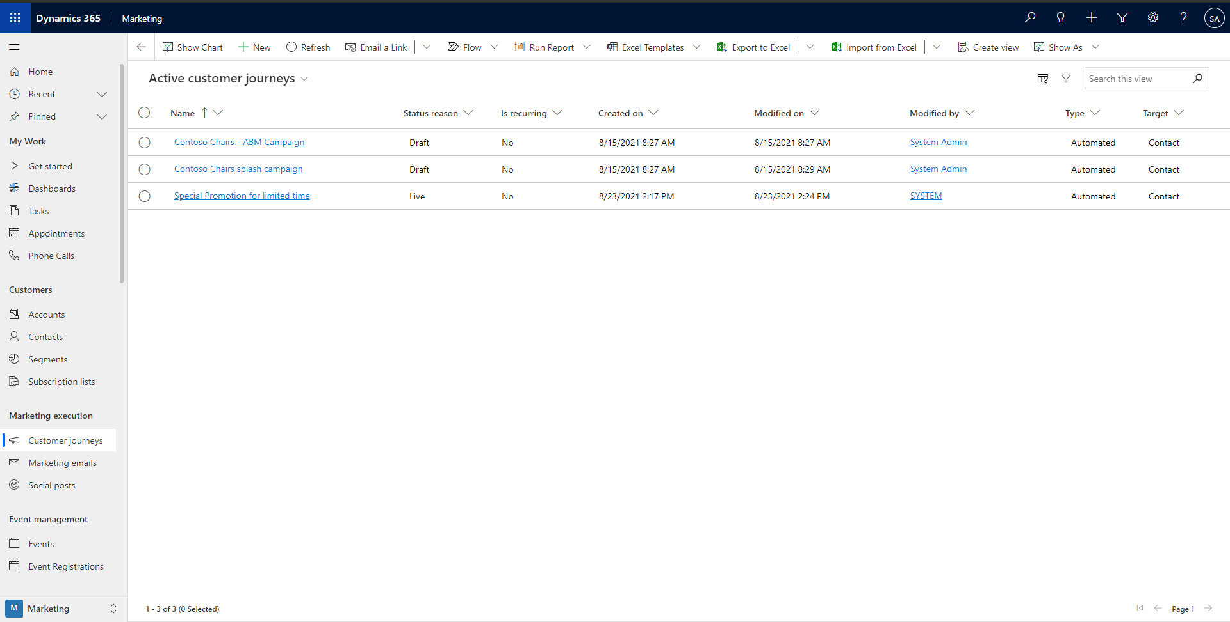

Slide 35
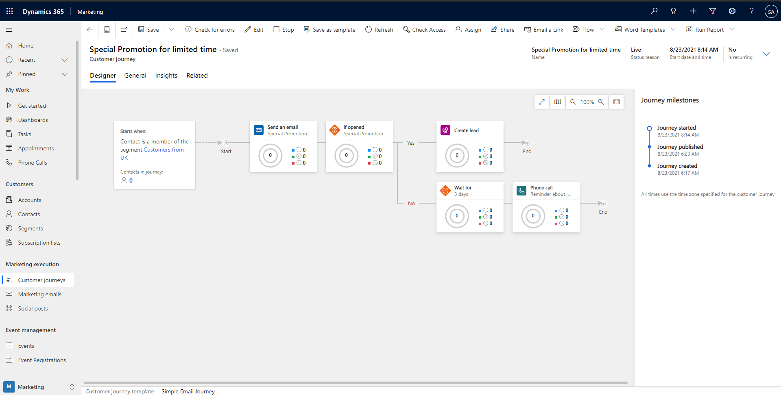

Slide 36
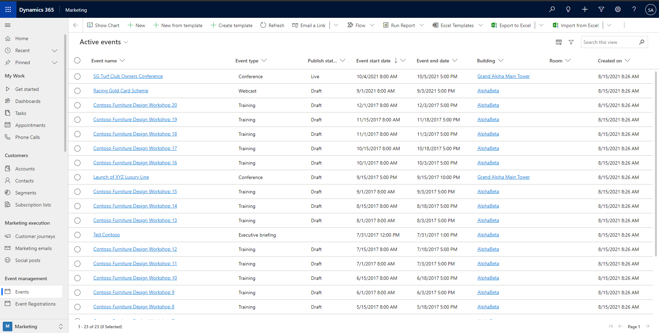

Slide 37
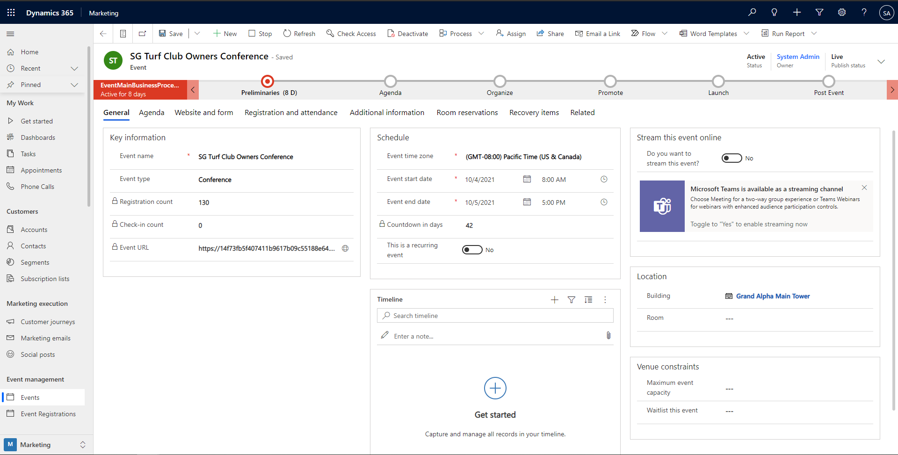

Slide 38
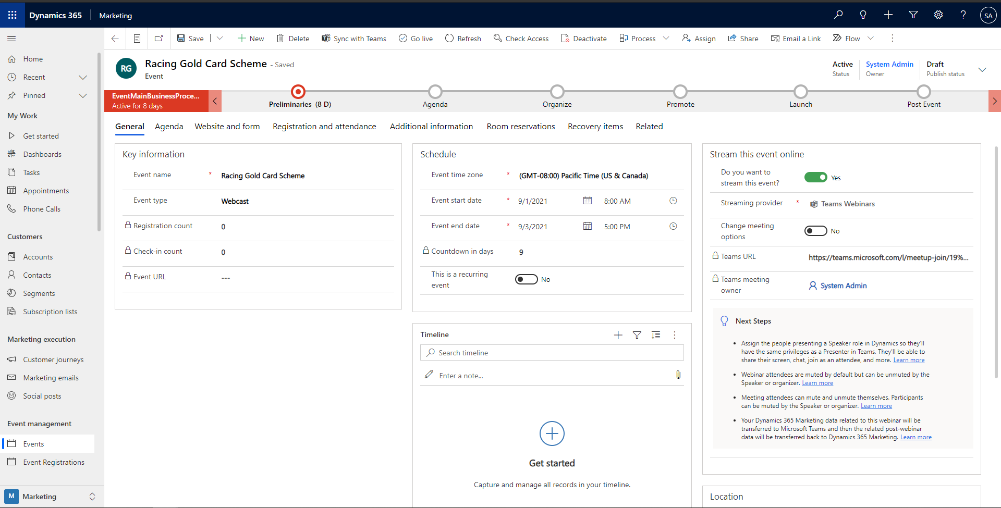

Slide 39
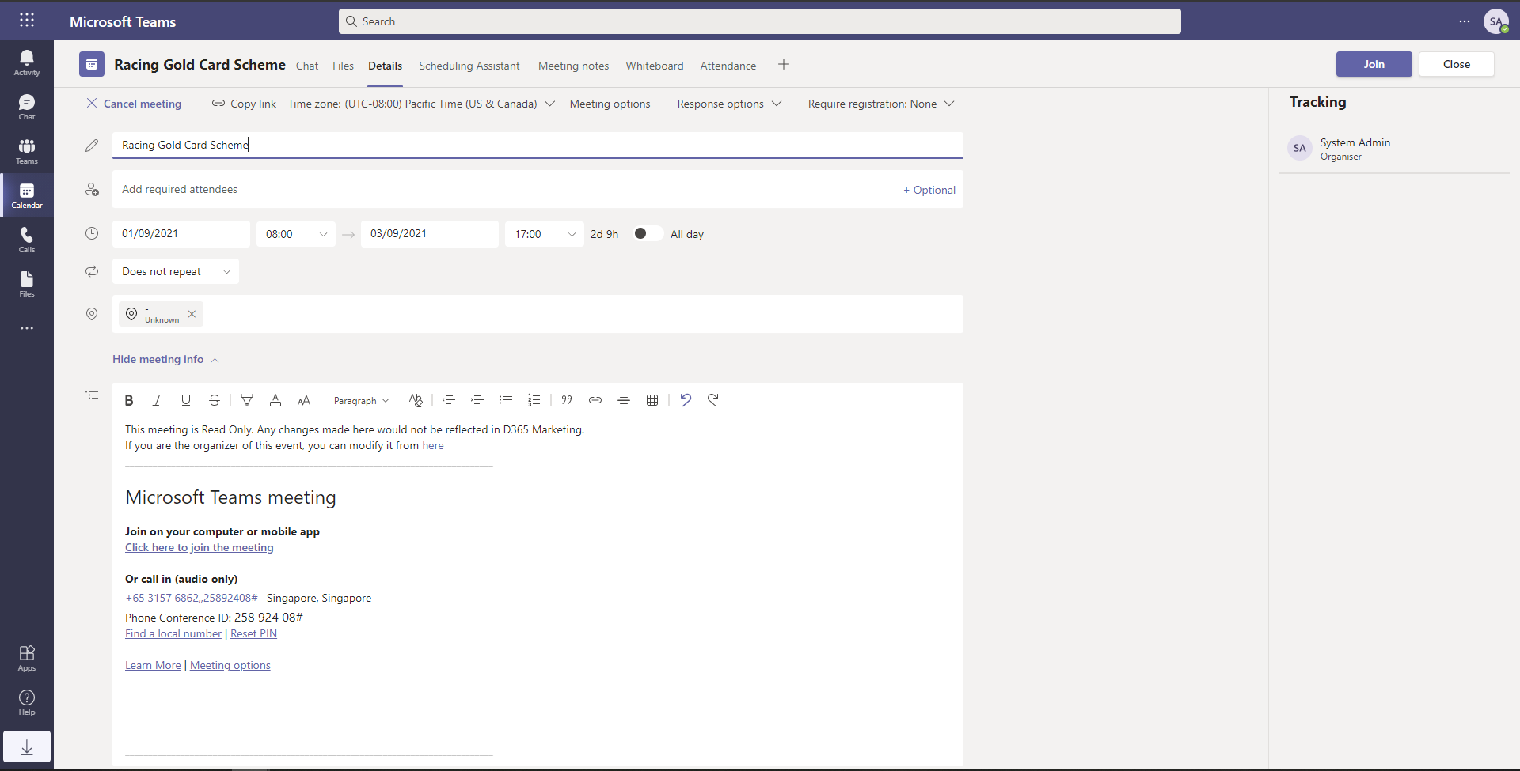

Slide 40
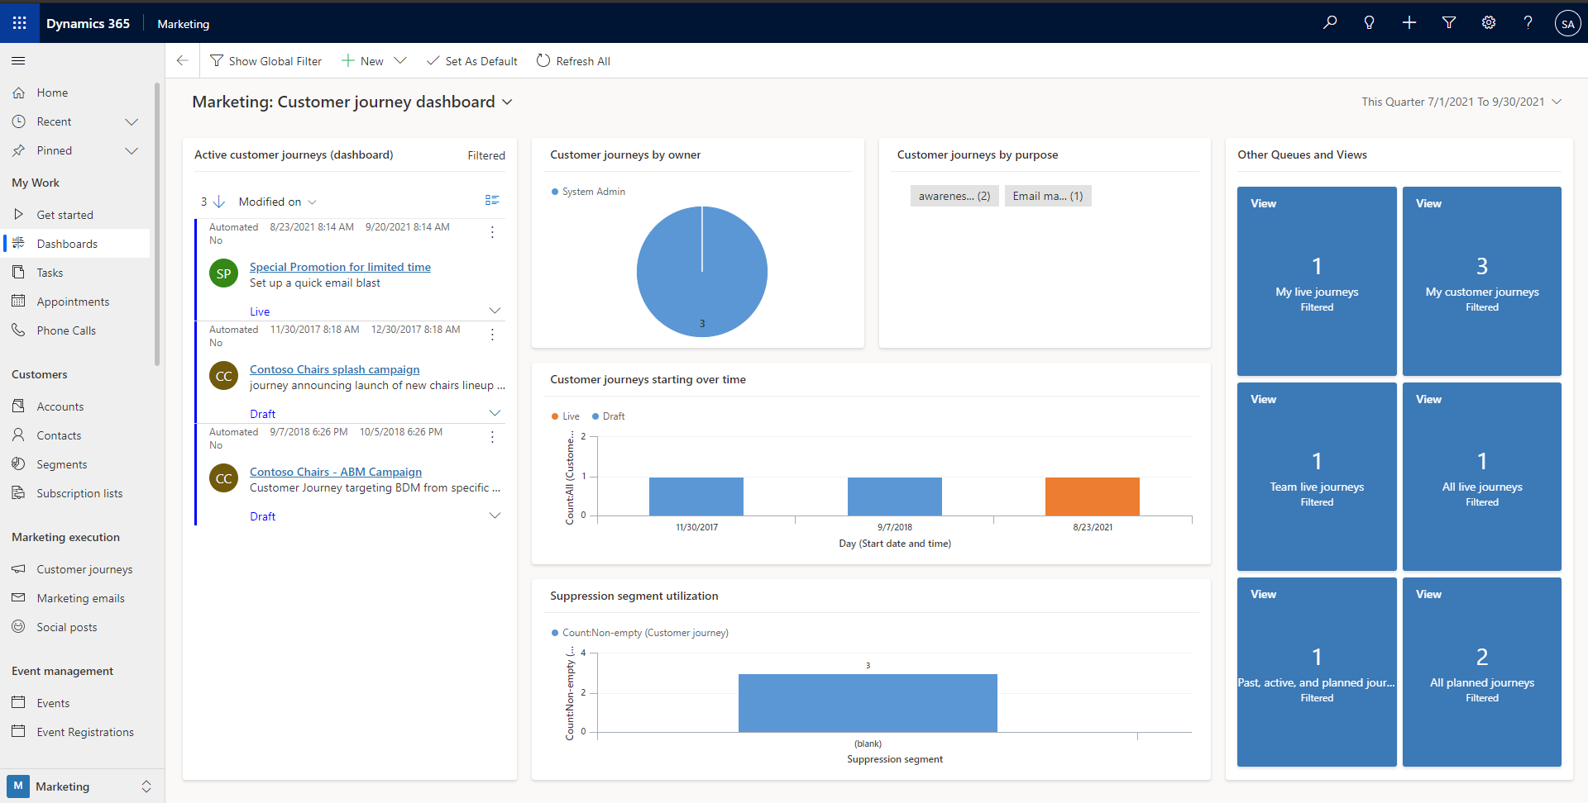

Slide 41
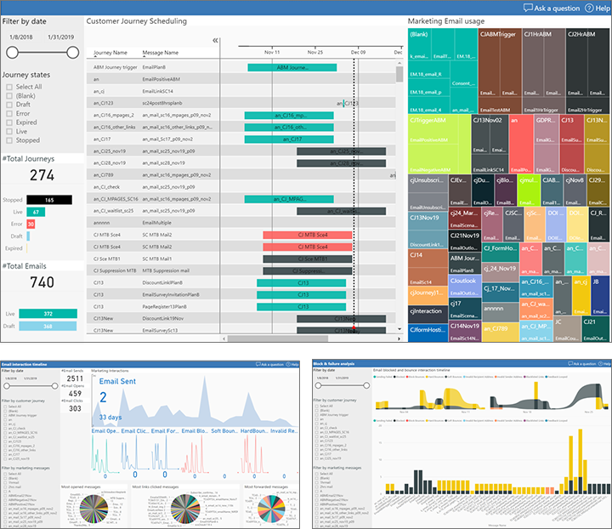
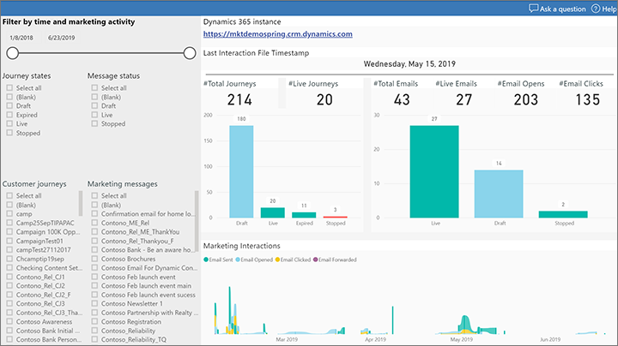
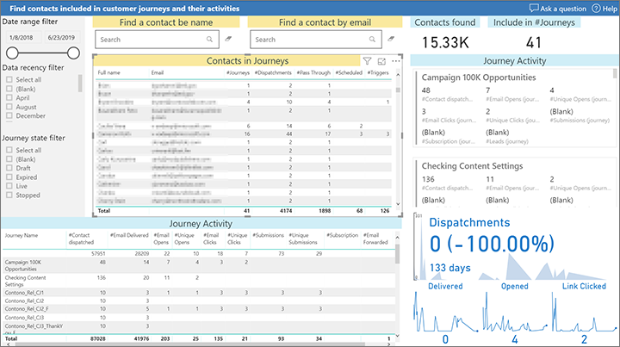

Slide 42
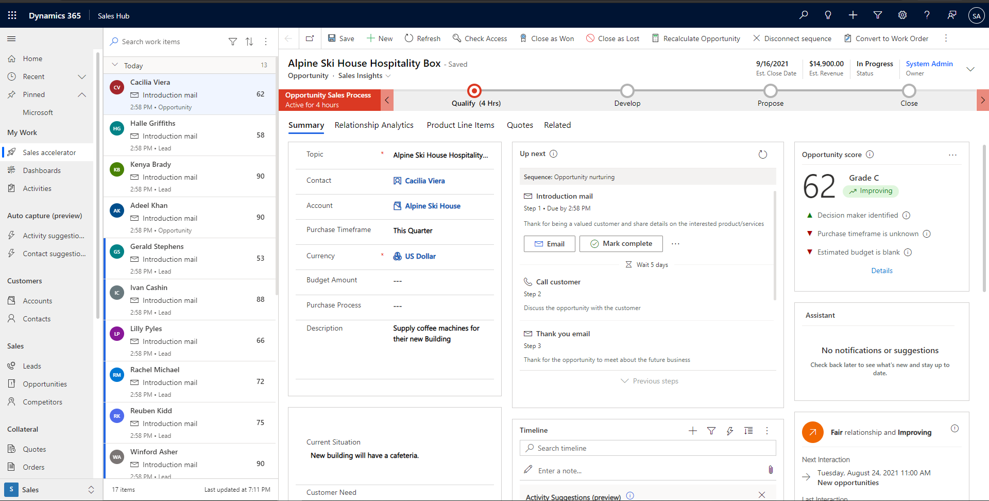

Slide 43
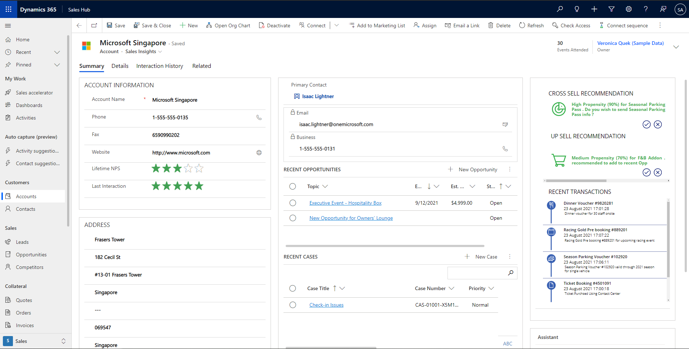

Slide 44
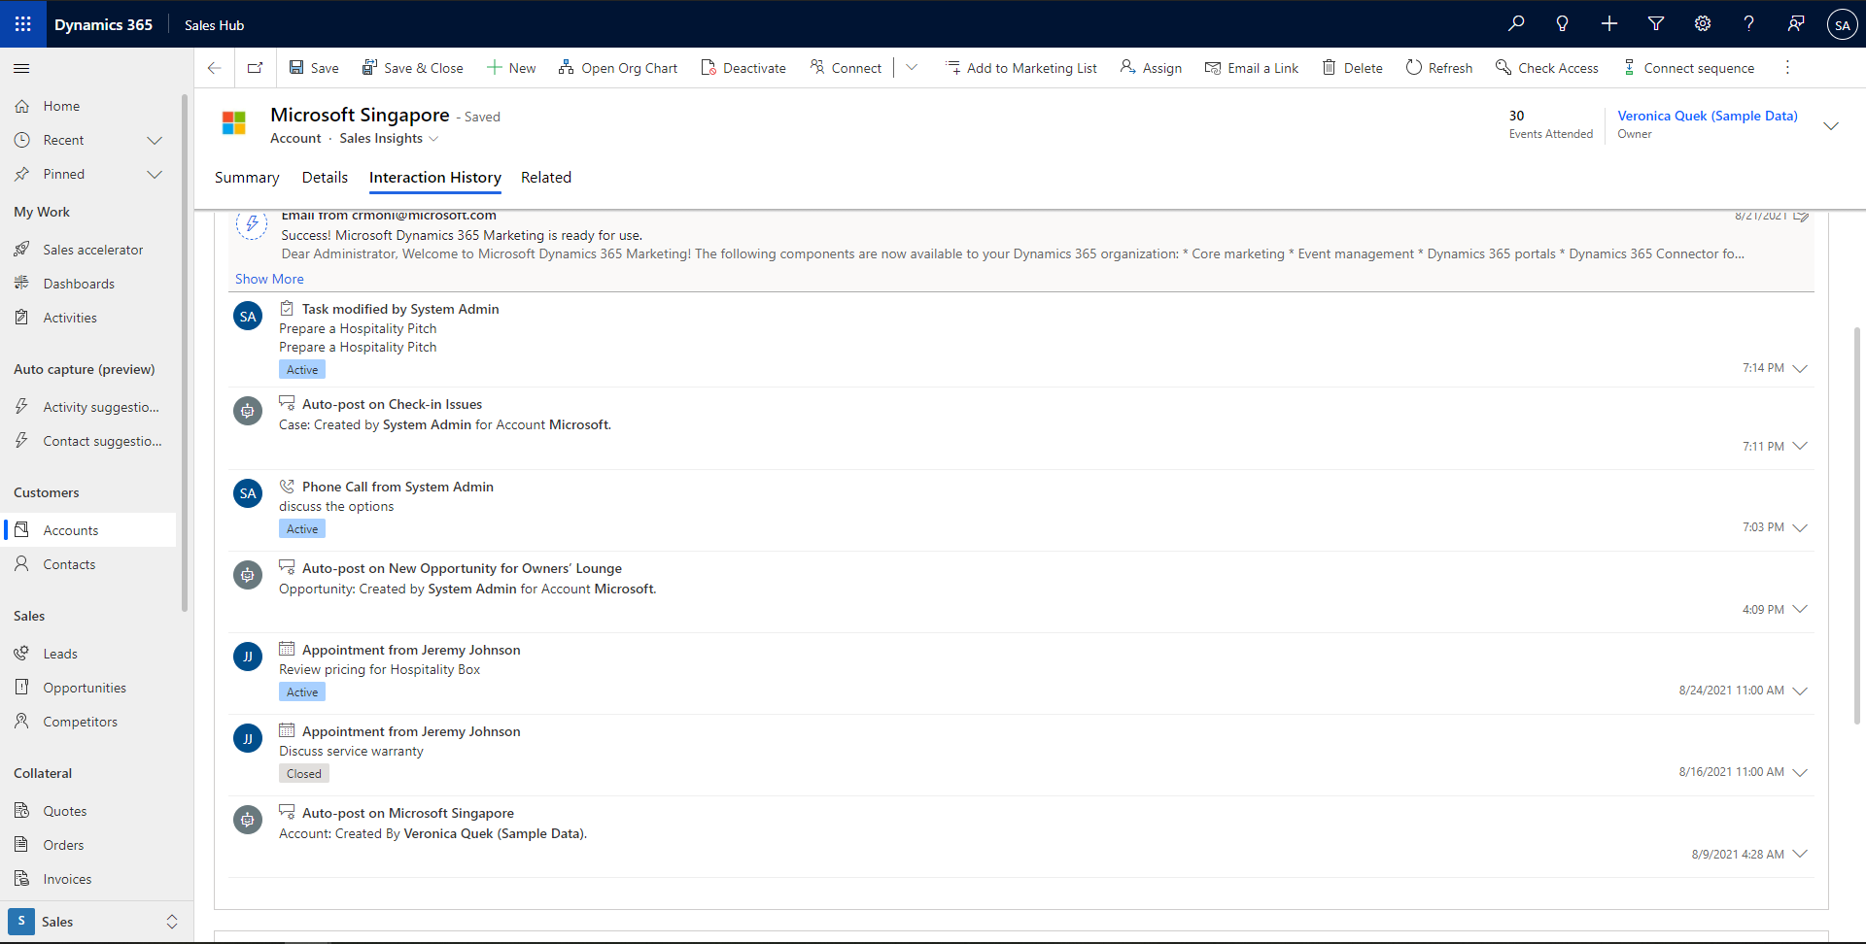

Slide 45
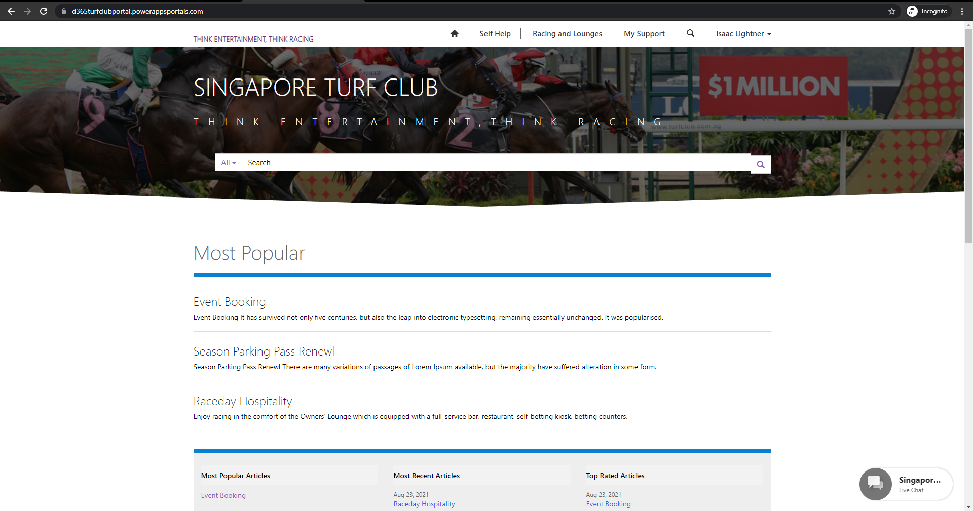

Slide 46
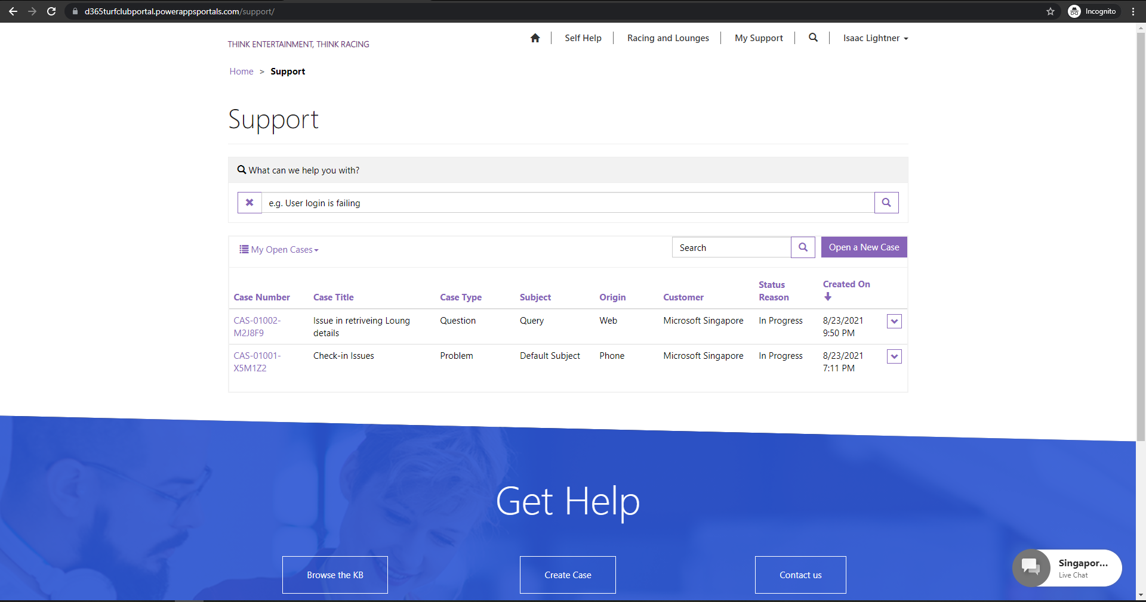

Slide 47
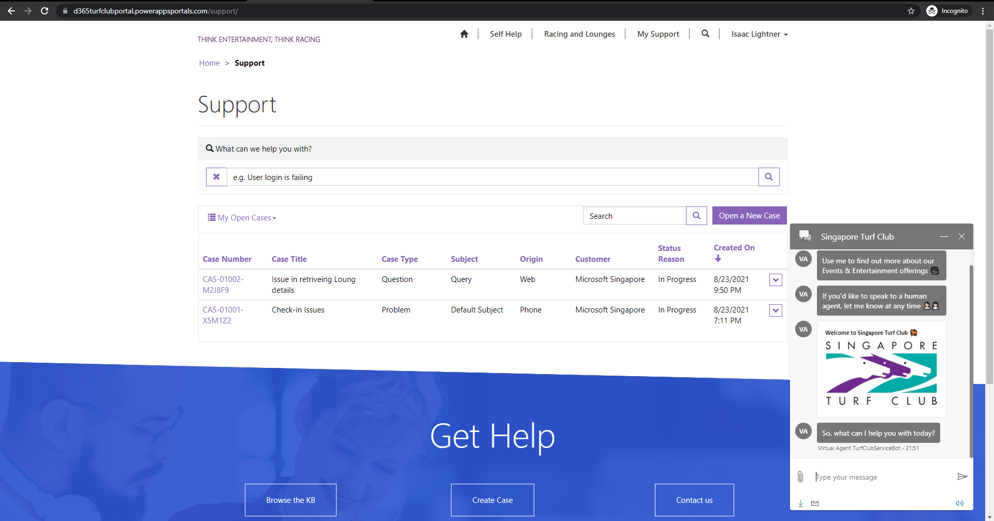

Slide 48
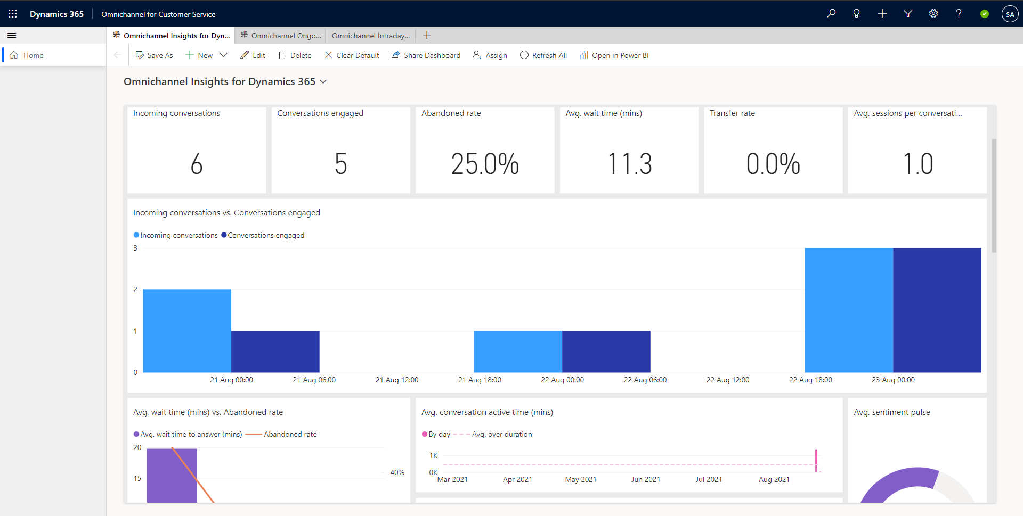

Slide 49
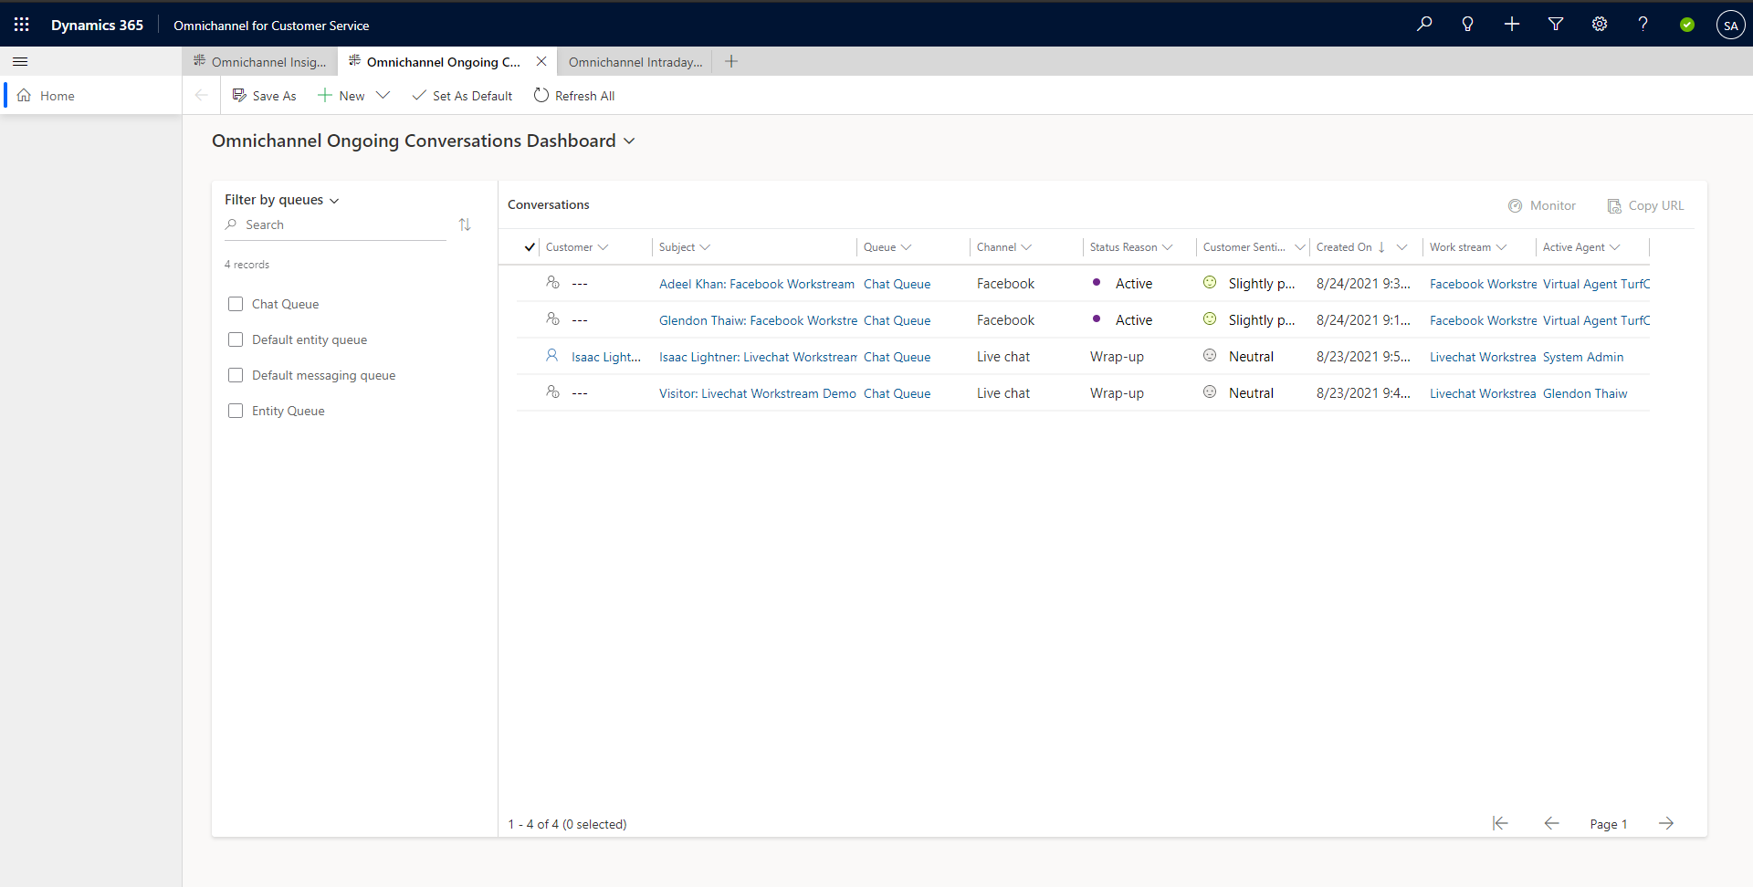

Slide 50
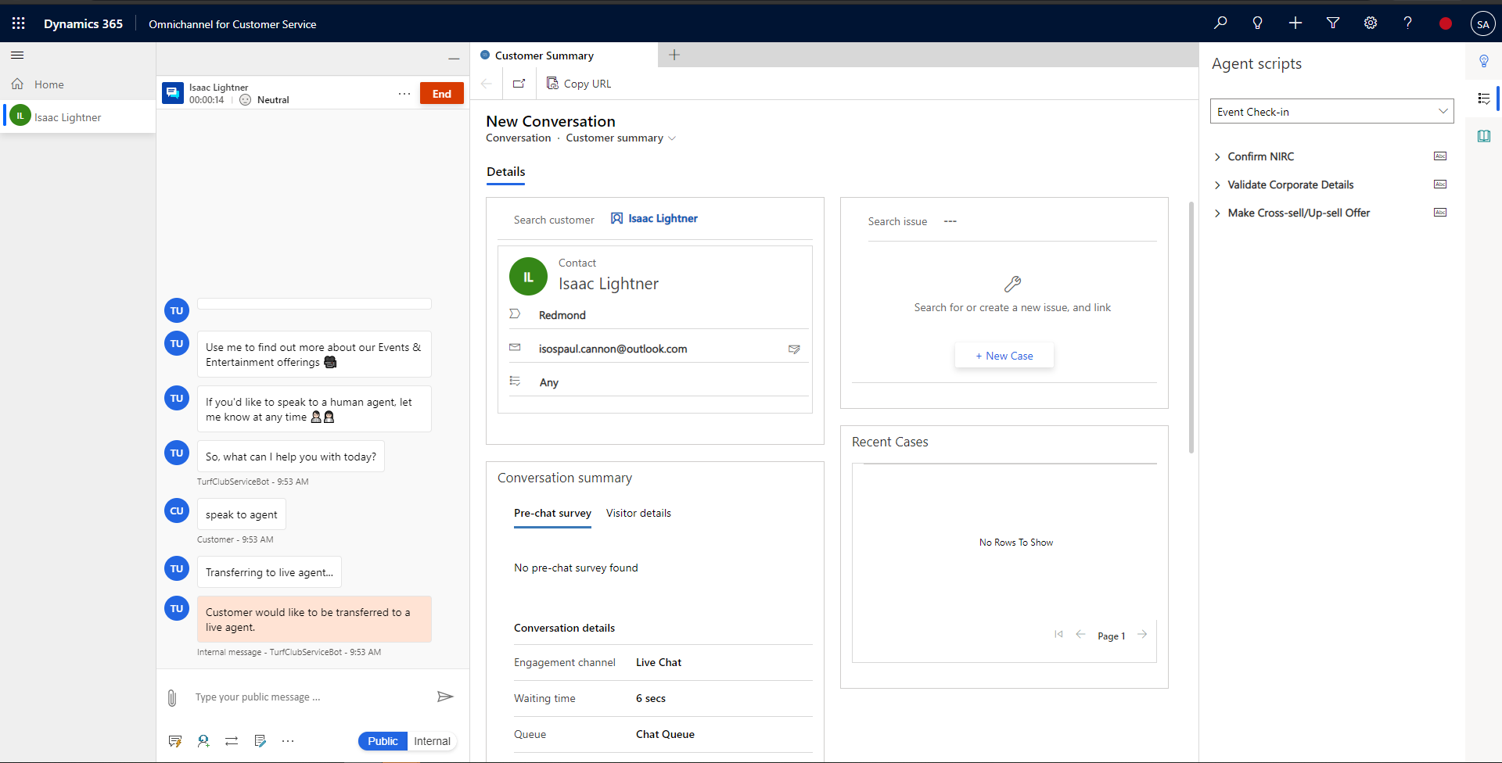

Slide 51








































Current Dynamics Use Cases in Singapore Public Sector
Contact/Account Management
360 View of Interactions and relationships
Case Management
Service Request, Feedback, Complaint, Enquiry, Knowledge Management
Outreach & Stakeholder Engagement
Campaign / Event Management, Email Blast, Registrations & Attendance, Follow-ups
xRM
Other enterprise workflows like internal requests, other inspection or other custom enterprise processes

Slide 52
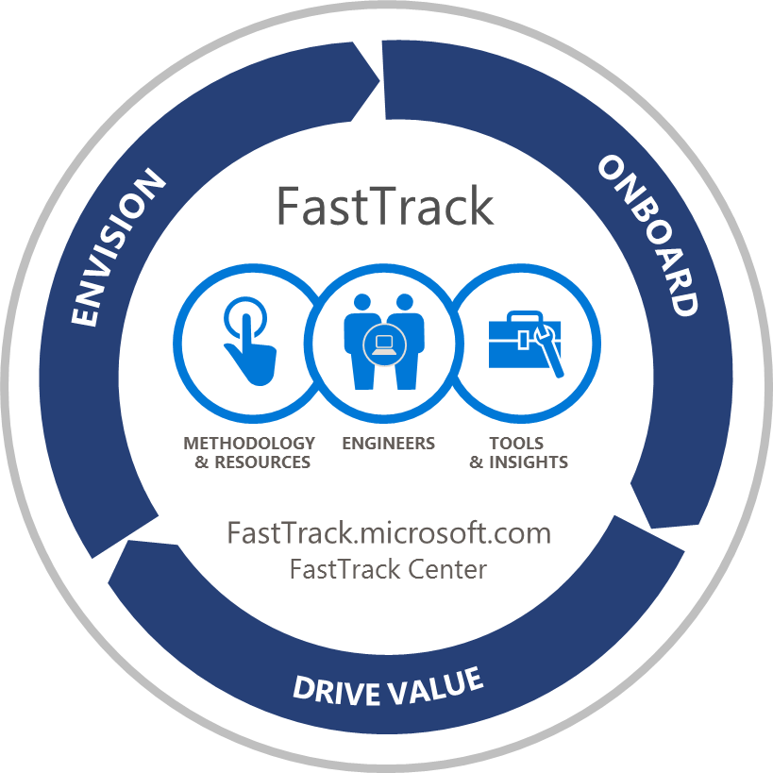
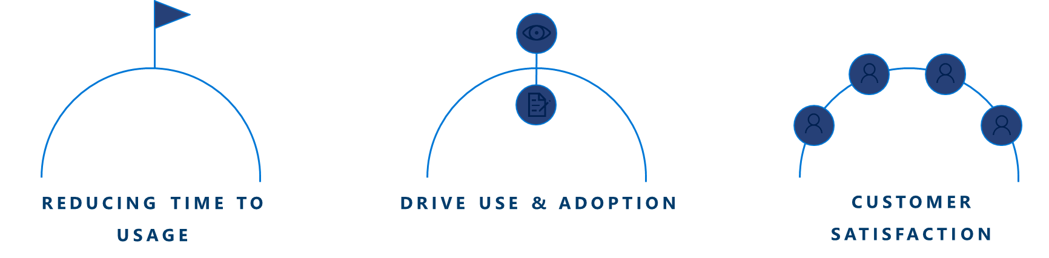
Customer Success Manager (CSM) Singapore Public Sector
Helping you exceed your business goals, deriving maximum and measurable ROI through adoption and higher end-user usage
We diligently drive proactive and continuous engagement with key business decision makers within your organization
We enable maximum usage and adoption of Microsoft Dynamics 365 solution
We deliver a customer success plan that maps out the journey to high levels of adoption of the solution
DIRECT ENGINEERING ENGAGEMENT FOR QUALIFIED CUSTOMERS
DESIGNED TO ASSIST THROUGH THE ONBOARDING/ DRIVE VALUE PHASES
DELIVERED REMOTELY, VIA A TEAM OF TIMEZONE-BASED ENGINEERS
Notes:
Already made great progress against our roadmap and here are the current live integrations
Campaign Orchestration: Integration between Campaign and Dynamics
Problem:
Sales and marketing departments tend to communicate with prospects and customers in isolation creating to data silos and leading to inconsistent messaging across orgs and lost revenue opportunities
Benefits:
Provides 360 degree view of customers and new understanding of customer journey for consistent messaging across sales and marketing
Gives sales visibility into campaign responses and their impact on lead disposition to direct sales actions
Gives marketing visibility into customer-specific sales actions to inform most relevant marketing campaigns
Through use of lead scoring and nurturing, sellers can prioritize opportunities, shorten sales cycles, and optimize processes leading to more revenue opportunities
Digital Foundation: Integration between AEM Sites, Assets, and Form and Dynamics
Problem:
Disjointed customer profiles with no single view of customer
One size fits all web and content approach which does not take advantage of everything you know about your customers
Low online conversions due to abandoned online forms and cumbersome sign up processes reducing the number of leads in the funnel
Solution:
AEM can pull in known user data from Dynamics to personalize sites, assets, and forms based on user’s known interactions with the company
Interactions of unknown customers within AEM and Campaign can trigger new customer profiles in Dynamics to build a view of who that person is and what they are interested in to create a holistic view of the customer
A single view of the customer journey allows for effective journey management and consistent and personalized messaging on a massive scale eliminating need for manual updating
Benefits:
Increased time to market with rapid campaign rollout
Increased campaign conversion and retention rates with real time analytics and marketing optimization
Sales Acceleration: Integration between Sign and Dynamics
Problem:
Frustrating delays in contract approvals, business risks in contract process, and lack of visibility into contract status
Solution:
Simplifies approvals by sending documents for signature from within Dynamics no longer requiring collection of signatures, log change requests, etc.
Reduces business risks in contract process by reducing room for human error – adding data from Dynamics into contracts and capturing data from signed agreement back into customer record with complete audit trail for every transaction and digital seal ensuring contract integrity
Improves visibility of contract status which can be monitored directly within Dynamics to empower reps and allow for better forecasting
Speeds up time to revenue with sales reps sending documents from within Dynamics, recipients signing contracts without downloading software or signing up for an account, and contracts being distributed to all parties once signed
Benefits:
Helps organization get to success faster
Customer Intelligence: Integration between Analytics and Power BI
Problem:
Analytics and IT teams have ongoing burden to accommodate requests for new and one-off reports in addition to updates and analysis of customer data and campaigns which is extremely time consuming and reduces ability to quickly take action on data
Solution:
Allows for data democratization by providing the enterprise instant access to digestible real-time visualizations and insights from any device without relying on email or separate reporting tool
Amplifies power of Analytics data by combining it with disparate data sources to identify new trends and opportunities
Offers mobile accessibility to keep stakeholders informed anytime and anywhere through Power BI app
Allows for self-service due to ease of integration so analysis and visualization capabilities are accessible at org level
Benefits:
Improve ROI with faster, more informed decisions
Targeted Advertising: Integration of Audience Manager and Bing
Problem:
Lack of an integration between an organization’s rich 1st party data and their search strategy
Solution:
Allows Bing search advertisers to leverage their own 1st party audience segments ported from AAM for custom audience buying on Bing
Syncs via server-to-server integrations (rather than relying on site visits for pixel fires) for real-time segment population updates giving marketers the most accurate representation of their target audience
Can adjust keyword search bids and customize messaging and landing page experiences based on previous actions and site activity
Can leverage lookalike modeling to expand reach
Benefits:
Optimize paid search and advertising to improve ROI

Slide 53
Summary and Next Steps
We have explored the Power of Dynamics 365 to transform Singpore Turf Club’s customer touchpoints
Enhanced Relationship Management with deep insights
Streamlined and Consistent Case Management with integrated Knowledge Management
Minimal Disruption to Existing Customer Experience while Driving Major Transformational Impact
If you’re ready to take the next step to a Unified and Intelligent customer engagement platform, let’s get started today
Join us for a deep-dive Envisioning Workshop
Engage a services partner
We’d be happy to continue our discussion with you on the power of the Microsoft platform – Its extensibility and integrated capability, including integration of Dynamics across Microsoft products (e.g. Microsoft 365 and Azure)

